Slide 1
COMP 469 | Introduction to Artificial Intelligence
Markov Decision Processes II
Bellman equations, value iteration, and policy methods
AIMA 4e
Berkeley CS 188
Fall 2026
Sections 17.1 - 17.2
Lecture 10
CSU Channel Islands
Slides adapted from materials by Dan Klein and Pieter Abbeel, UC Berkeley CS188 (ai.berkeley.edu), and from Russell & Norvig, Artificial Intelligence: A Modern Approach, 4th edition.
Notes:
Welcome back. Last time we defined MDPs and talked about what a policy is. Today is the machinery lecture: we write down what 'optimal' means as a system of equations, then we build three algorithms that all turn out to be the same equation wearing different hats. Set expectations honestly: today has more equations than any lecture so far, and they will all look alike. That is not a bug. There are about four ideas here, remixed. If students leave able to write down a one-step lookahead from scratch, the lecture worked. Housekeeping: this material is heavily represented on the exam and is the direct foundation for reinforcement learning, which starts next lecture.

Slide 2
Where this sits in the course
Ch. 3-4
Ch. 5
Ch. 16
Ch. 17
Ch. 22
Search
Games
Utility
MDPs
RL
Deterministic.
You know exactly
what actions do.
An adversary
chooses some of
the outcomes.
One-shot decisions
under uncertainty.
MEU.
Sequential decisions
under uncertainty.
You are here.
Same problem, but
the rules are
hidden from you.
The through-line: every one of these is a one-step lookahead. What changes is who picks the next step, and how much you know about what happens after it.
COMP 469 | Markov Decision Processes II
2
Notes:
Orient students before the equations start. Search: deterministic, one agent, you know the successor function. Games: still deterministic transitions, but a second agent picks half the moves, so we introduced min nodes and then chance nodes for expectimax. Chapter 16 gave us utility theory for a single decision under uncertainty: maximum expected utility. Chapter 17 makes that decision sequential. Chapter 22 keeps the MDP but takes away the transition and reward functions, so you have to learn them by acting. Emphasize the closing line. If they see the one-step lookahead as the unifying object, the rest of the semester gets easier.

Slide 3
By the end of today you should be able to
1
Formalize
State an MDP precisely, and explain why a policy - not a plan - is the right notion of a solution.
2
Justify
Explain why we discount, and what breaks if we do not: infinite utilities, improper policies, nonstationary behavior.
3
Derive
Write the Bellman equations for V*, Q*, and V-pi from scratch, and read any one of them out loud in English.
4
Compute
Run value iteration and policy iteration by hand on a small MDP, and extract a policy from values or from Q-values.
5
Analyze
Say why value iteration converges, how fast, and when to stop - and why the policy is usually right long before the values are.
COMP 469 | Markov Decision Processes II
3
Notes:
Read these out. The verbs matter: formalize, justify, derive, compute, analyze. Exam questions are written against these verbs. Objective 5 is the one students most often skip and most often lose points on. 'It converges' is not an answer; 'the Bellman operator is a gamma-contraction in max norm, so the error shrinks by a factor of gamma every sweep' is an answer. Tell them the derive objective is literally a common exam prompt: given a variant setup, write the corresponding one-step lookahead.

Slide 4
One idea, two notations
Read this slide once now, and again when the textbook and the slides seem to disagree
Concept | AIMA 4e (the textbook) | Berkeley CS188 (these slides)
Transition model | P(s' | s, a) | T(s, a, s')
Reward on a transition | R(s, a, s') | R(s, a, s')
Utility / value of a state | U(s) | V*(s)
Value under a fixed policy | U-pi(s) | V-pi(s)
Action-utility function | Q(s, a) | Q*(s, a)
Optimal policy | pi*(s) | pi*(s)
Discount factor | gamma | gamma
The one that trips people up: AIMA writes U(s) for the utility of a state under optimal behavior. That is exactly the same object CS188 calls V*(s). The star is not decoration - it is the difference between V-pi and V*.
COMP 469 | Markov Decision Processes II
4
Notes:
Spend a real minute here. Half the confusion in this unit is notational, not conceptual. Students read the book at home in P-notation and see T-notation on the slides. T(s,a,s') and P(s'|s,a) are the same number: the probability of landing in s-prime given that you took a in s. AIMA even says some authors use T; that is us. The U versus V* point is the important one. In AIMA, U(s) already means 'utility under optimal play' - the star is implicit. When we want the value of a specific, possibly bad policy, AIMA writes U-pi and we write V-pi. I will use the CS188 star notation throughout because we need to talk about non-optimal policies constantly today.

Slide 5
01
Sequential Decision Problems
The 4 x 3 world
Transitions and the Markov assumption
Rewards on transitions
Plans versus policies
How rewards shape behavior
AIMA 17.1 | What the problem is, and what counts as a solution
COMP 469 | Markov Decision Processes II
5

Slide 6
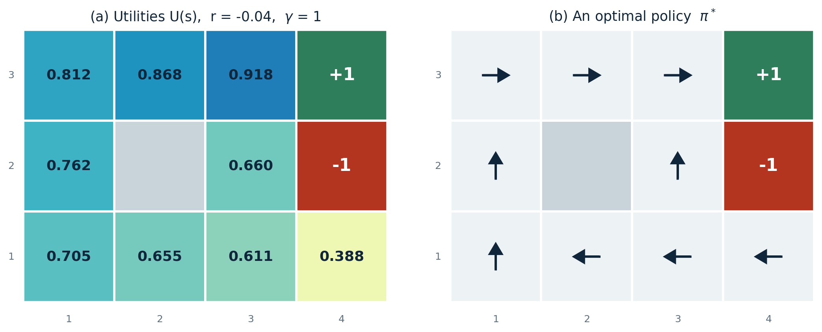
Recap: Grid World
The board
The agent lives on a grid. Walls block movement. Two terminal squares end the episode: a gem worth +1 and a pit worth -1.
Noisy movement
The intended action happens 80% of the time. 10% of the time the agent slips 90 degrees left, 10% right. Bumping a wall means you stay put.
Rewards
A small living reward arrives on every single step and can be negative. The big rewards arrive at the end.
Noise is a property of the environment, not of your solution. You do not get to choose it.
The goal
Maximize the sum of (discounted) rewards - not the probability of reaching the gem.
COMP 469 | Markov Decision Processes II
6
Notes:
Quick recap - do not re-teach this, just reload it. Ask the room for the noise number rather than telling them. Two things to stress. First, the living reward is invisible in the visualization but it is doing most of the work in shaping behavior; we will see that in a few slides. Second, contrast with chess and minimax: there, reward came only at the end. Here rewards trickle in, which means the timing of a reward matters, not just its size. The wall-bumping rule creates the counterintuitive corner cases students love: sometimes the optimal action is to walk deliberately into a wall, because the two slip directions are both safe while the intended direction is not.

Slide 7
Why a plan is not a solution
If the 4 x 3 world were deterministic, the answer is a five-move plan:
[ Up, Up, Right, Right, Right ]
So what is a solution?
The agent may end up in a state the plan never anticipated.
So a solution must say what to do in every state the agent could reach - not what to do at every time step.
That object is a policy, written pi. The action it recommends in state s is pi(s).
No matter how badly the dice fall, the resulting state is still in the policy, and the agent still knows what to do next.
But actions are unreliable, so that exact sequence only arrives at the gem with probability
0.8⁵ = 0.32768
There is also a small chance of stumbling to the goal the long way around, with probability 0.1^4 x 0.8, for a grand total of 0.32776.
A 32% success rate is not a bug in the plan. It is evidence that plans are the wrong data structure for this problem.
COMP 469 | Markov Decision Processes II
7
Notes:
Work the 0.8^5 arithmetic on the board - it lands better than reading it. Five moves, each has to go right, 0.8 to the fifth is about a third. Then ask: what should the agent do if the very first Up slips it east into (2,1)? The plan has no answer. It says 'Up' next, but 'next' was written for a different state. That is the whole argument for policies in one question. Also worth flagging the 0.32776 detail from the book: there is a second route to the goal going the long way round, so the true success probability of that action sequence is very slightly higher than 0.8^5. It is a nice reminder that you have to sum over all paths, not just the intended one.

Slide 8
The transition model and the Markov assumption
The outcome of an action is a distribution, not a state:
P(s' | s, a) = T(s, a, s')
Worked example: Up from (1,1)
0.8
moves Up to (1,2)
the probability of reaching s' if action a is taken in state s
Markovian
0.1
slips East to (2,1)
The probability of reaching s' from s depends only on s and a - never on the history of states that came before. The present state is a sufficient summary of the past.
0.1
slips West into a wall,
so it stays at (1,1)
This is an assumption about your state representation, not a law of nature. If the future genuinely depends on history, the fix is to put the relevant history into the state.
Note that the three outcomes are not three different states - two of them collide. Always collect duplicate outcomes before you average.
COMP 469 | Markov Decision Processes II
8
Notes:
The worked example on the right is the one to walk through slowly. From (1,1), Up gives 0.8 to (1,2), 0.1 east to (2,1), and 0.1 west - but west is a wall, so the agent stays at (1,1). Students consistently forget the wall case and end up with probabilities that do not sum to one. The bottom note matters for the homework: when two slip directions both bounce off walls, they collapse into the same successor and you must add the probabilities. In the code I gave you this is the dictionary accumulation step. On Markov: push back on the idea that this is restrictive. Chess is Markov if the state includes castling rights and en passant. The assumption is really a contract about what you put in the state.

Slide 9
Rewards live on transitions
R(s, a, s') - received on the transition from s to s' via action a
1
Bounded
2
Additive
3
Instantaneous, not total
Rewards may be positive or negative but are bounded by plus or minus R-max. We will lean on that bound when we prove convergence.
The utility of a history is (for now) the sum of the rewards received along it.
Keep the reward on one step strictly separate from the utility of the whole episode. Mixing them up is the single most common error in this unit.
In the 4 x 3 world
( 9 x -0.04 ) + 1 = 0.64
Every transition earns -0.04, except those entering a terminal square, which earn +1 or -1. So if the agent reaches the gem after 10 steps, its total utility is
The -0.04 is not flavor text. It is what makes the agent want to leave. Without it, dawdling is free.
COMP 469 | Markov Decision Processes II
9
Notes:
Point out that the reward is indexed by all three of s, a, and s'. Many treatments simplify to R(s), and AIMA's own Figure 17.3 is drawn in that older convention - we will hit that discrepancy explicitly in two slides. Do the 0.64 arithmetic aloud: ten steps means nine ordinary transitions at -0.04 plus the final one worth +1. Ask why it is nine and not ten - the tenth transition is the one that enters the terminal state and is worth +1 instead. Land the closing line hard. The living reward is the agent's incentive to finish. The book's phrasing is that the agent does not enjoy living in this environment, so it wants to leave as soon as possible. That makes the MDP a stochastic generalization of the search problems from Chapter 3, where path cost played the same role.

Slide 10
Definition: a Markov decision process
A sequential decision problem for a fully observable, stochastic environment with a Markovian transition model and additive rewards consists of:
The quantities we compute
Policy
S
a set of states, with an initial state s-zero
a map from states to actions
A(s)
the set of actions available in state s
Utility
a sum of discounted rewards along one history
P(s' | s, a)
the transition model
Value
R(s, a, s')
the reward function
expected future utility from a state (a max node)
Q-value
gamma
the discount factor, in [0, 1]
expected future utility from a q-state (a chance node)
Whenever you see MDP, think: non-deterministic search. Same states, same actions, same successor structure as Chapter 3 - only now the successor function returns a distribution instead of a state, and a reward rides along with each outcome.
COMP 469 | Markov Decision Processes II
10
Notes:
This is the formal definition slide - the one to photograph. Note that methods for solving MDPs are dynamic programming: break the problem into smaller pieces and remember the answers. Draw the parallel to Chapter 3 explicitly, because it demystifies the whole unit. Before, RESULT(s,a) gave you s'. Now T(s,a,s') gives you a distribution over s'. Everything else - state space, action sets, goal structure - carries over. The q-state is the concept students find weirdest, so introduce it gently here and revisit it later: a q-state is 'I am in s and I have committed to a, but the dice have not been rolled yet.' It is exactly a chance node in the expectimax tree.

Slide 11
Optimal policies and the utilities of states
Utilities and an optimal policy for the 4 x 3 world, r = -0.04. Utilities rise as you approach the +1 exit, because fewer steps means less accumulated living cost.
Note (1,1): the optimal action is Up, and from (3,1) the agent goes Left - the long way around - rather than Up past the pit. There are in fact two optimal policies here, because the agent is exactly indifferent at (3,1).
COMP 469 | Markov Decision Processes II
11
Notes:
Walk the values. Highest near the gem, lowest at (4,1) which is stuck next to the pit. The book's phrasing: utilities are higher for states closer to the +1 exit because fewer steps are required. The interesting square is (3,1). Going Up is quicker but risks slipping into the -1 at (4,2). Going Left is safer but longer. At r = -0.04 the agent is essentially indifferent, which is why the book says there are two optimal policies for this world. In general, multiple optimal policies are the norm, not the exception. A quick numbers check students can do at home: these are exactly the values in Figure 17.3. I generated them by running value iteration to convergence, not by copying the book.

Slide 12
A convention trap worth knowing about
Because the textbook is inconsistent with itself here
Reward on the transition
Reward at the state
V(s) = max_{a} Σ_{s'} T(s,a,s')[ R(s,a,s') + γ V(s') ]
U(s) = R(s) + γ max_{a} Σ_{s'} P(s'|s,a) U(s')
What the 4th-edition text actually defines. The reward is collected as you move.
The older convention the book's Figure 17.3 was drawn in. You are paid for occupying a state.
U(1,1) = 0.745
U(1,1) = 0.705
if you compute it from the stated model
the number printed in Figure 17.3
The gap is exactly r, on every non-terminal state. Both conventions give the same optimal policy - an additive constant cannot change an argmax. On the exam I will always state which convention is in force. In your own write-ups, state yours.
COMP 469 | Markov Decision Processes II
12
Notes:
This slide exists because sharp students will notice the mismatch and lose confidence in their own arithmetic. Better to name it than to let them think they are wrong. The 4th-edition text defines R(s,a,s') with reward collected on the transition. Figure 17.3, inherited from earlier editions, is drawn under R(s). Under the transition convention every non-terminal utility is exactly 0.04 higher, because the agent no longer gets paid for the square it starts on. The reassuring part, and a preview of Section 17.1.3: shifting all rewards by a constant cannot change which action is best, so the optimal policy is identical either way. That is the affine-invariance result we prove later in the lecture. Practical advice for their homework: pick a convention, write it at the top of the page, and be consistent.

Slide 13
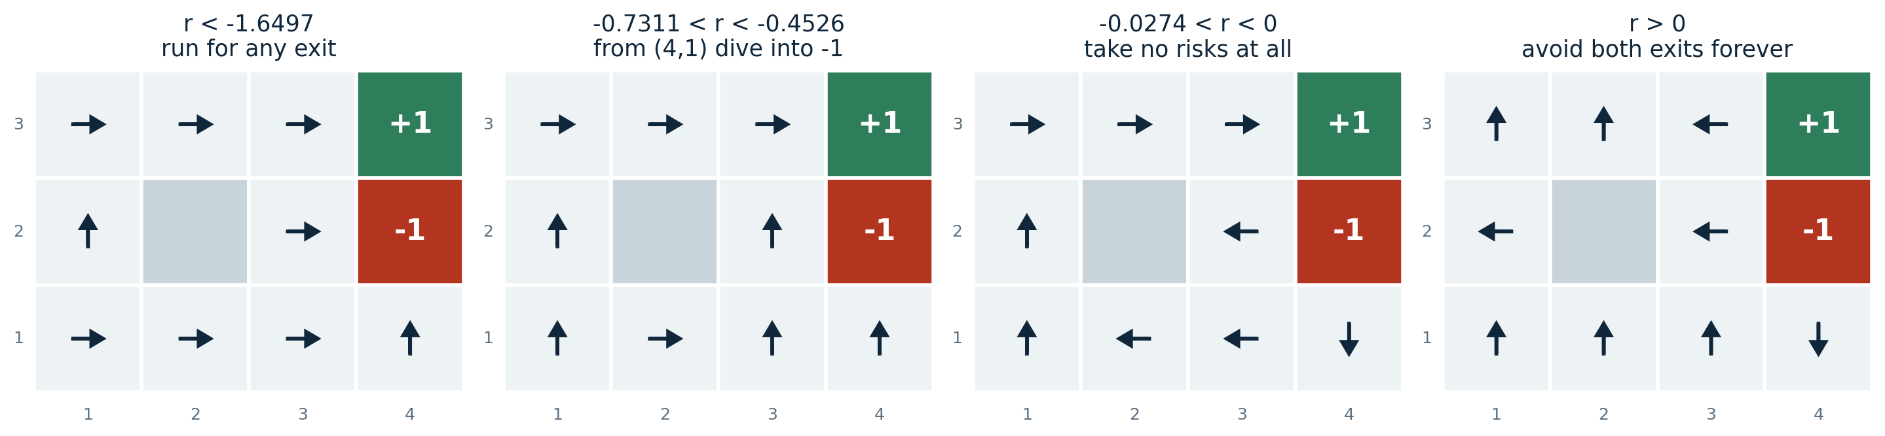
Behavior is a function of the living reward
Optimal policies for four ranges of r. The transition structure never changes - only the number you get paid per step.
Left to right: life is so painful that any exit will do, even the -1 | life is unpleasant enough that from (4,1) the agent dives into the -1 rather than pay for the long trip | life is only slightly dreary, so the agent takes no risks and even bangs its head on walls to stay clear of the pit | life is enjoyable, so the agent avoids both exits forever and collects infinite reward.
COMP 469 | Markov Decision Processes II
13
Notes:
This is the slide that convinces students reward design is a real engineering activity, not a formality. Same world, same physics, four completely different personalities, produced entirely by the living reward. Panel 3 is worth pausing on: at r = -0.02 the agent at (4,1) heads downward, deliberately into a wall, because bouncing off a wall is free and the two slip directions are both away from the pit. Students find this delightful and it is a genuine consequence of the model. Panel 4 is the cautionary one. When r > 0 the agent never terminates and gets infinite total reward. That is a policy that is optimal and useless. It is exactly the failure mode that motivates discounting, which is the next section. AIMA notes there are nine distinct optimal policies across all ranges of r. Exercise 17.THRC asks for them - a good extra-credit prompt.

Slide 14
02
Utilities Over Time
Finite vs infinite horizon
Stationary preferences
Additive discounted rewards
Taming infinite utilities
The utility of a state
AIMA 17.1.1 | Why we discount, and what goes wrong if we do not
COMP 469 | Markov Decision Processes II
14

Slide 15
First question: is there a deadline?
Finite horizon
Infinite horizon
There is a fixed time N after which nothing matters. The game is simply over.
No fixed deadline. There is then no reason to behave differently in the same state at different times.
Start at (3,1) with N = 3: the agent must head straight for the gem, so the optimal action is Up.
So the optimal action depends only on the current state, and the optimal policy is stationary: one action recommendation per state, good forever.
Start at (3,1) with N = 100: there is plenty of time, so take the safe route and go Left.
Careful: infinite horizon does not mean every episode is infinitely long. It means there is no fixed deadline. An infinite-horizon MDP can still contain terminal states.
The optimal action depends on how much time is left. A policy that depends on time is called nonstationary - you need a different policy for every remaining horizon.
This is the case we work in for the rest of the chapter. It is strictly simpler.
Every algorithm we build today assumes stationarity. That is why a policy can be a plain lookup table from states to actions, with no clock in it.
COMP 469 | Markov Decision Processes II
15
Notes:
The N=3 versus N=100 example from the book is the cleanest way to make nonstationarity concrete. With three steps left you have no choice but to gamble; with a hundred you can afford to be careful. Same state, different optimal action. The practical consequence: under a finite horizon your policy is not a table indexed by state, it is a table indexed by state and time remaining. That is N times bigger and you have to recompute it as the clock runs down. Make the caveat explicit because it confuses people: infinite horizon does not mean infinite episodes. Our 4 x 3 world has terminal states and most policies reach them. Infinite horizon just means no external deadline is imposed.

Slide 16
Second question: how do we score a whole history?
A history is a sequence of states and actions. Its utility is written U-h. We will use additive discounted rewards:
U_{h}([s₀, a₀, s₁, a₁, s₂, ...]) = R(s₀,a₀,s₁) + γ R(s₁,a₁,s₂) + γ² R(s₂,a₂,s₃) + ...
Stationary preferences
Why that matters
If two histories start with the same first transition, then they should be ranked the same way as the two histories you get by deleting that shared first step.
Stationarity looks like a mild, almost invisible assumption. But it is enormously restrictive:
Additive discounting is the only form of utility on histories that satisfies it.
In English: if you prefer one future to another starting tomorrow, you should still prefer it if it started today instead.
We are not choosing discounting for convenience. Given stationary preferences, we have no other option.
Note that gamma = 1 recovers the purely additive case, and that additivity was already lurking in the path-cost functions we used for heuristic search back in Chapter 3.
COMP 469 | Markov Decision Processes II
16
Notes:
This is a slide students skim and should not. The uniqueness result is genuinely surprising: from an axiom that sounds like nothing - your ranking of futures should not depend on when you evaluate them - you get geometric discounting and nothing else. Draw the multiattribute connection if you have time: each transition is an attribute of the history, and stationarity is a preference independence assumption in the sense of Section 16.4. The payoff for the students is that they stop treating gamma as an arbitrary knob. It is forced on them by the structure of their own preferences.

Slide 17
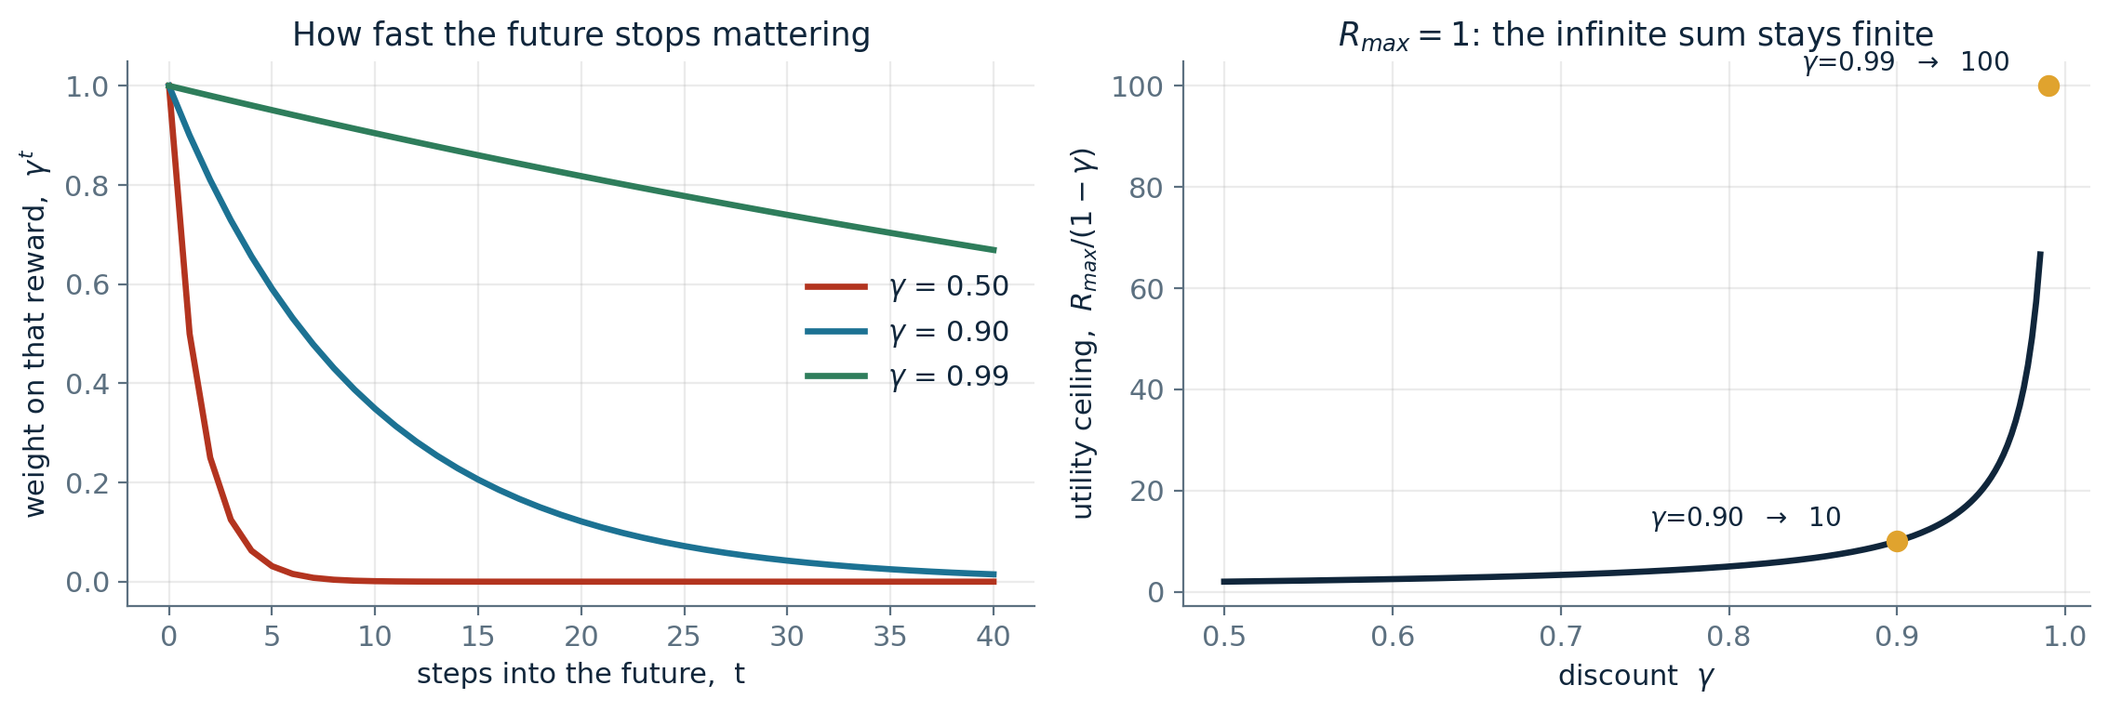
What the discount factor actually buys you
Left: how quickly a reward t steps away stops mattering. Right: with R-max = 1, the total utility of an infinite history is bounded by 1/(1 - gamma).
gamma near 0
gamma near 1
gamma = 1
The agent is myopic. Distant rewards are noise.
The agent is patient and will wait for a payoff.
No discounting at all - the purely additive case.
COMP 469 | Markov Decision Processes II
17
Notes:
Left panel: at gamma = 0.9, a reward twenty steps out is worth about 12 percent of its face value. At gamma = 0.5 it is worth essentially nothing. This is why the discount, not the reward magnitude, often decides behavior. Right panel previews the convergence argument. Because the series is geometric, the whole infinite future is bounded by R-max over one minus gamma. At gamma = 0.9 that ceiling is 10; at 0.99 it is 100. Notice how sharply it blows up as gamma approaches 1 - that is the same reason value iteration slows down at high gamma. There is an important student question buried here, which came up in the Berkeley lecture: can I just pick a small gamma to make my algorithm converge faster? No. Gamma is a property of the problem you were handed, not a solver setting. Changing it changes which policy is optimal, so a steeply discounted solve answers a different question than the one you were asked.

Slide 18
Three ways to keep utilities finite
With no terminal state and no discount, every history scores positive infinity - and infinity is not a useful thing to compare
1
Discount
2
Proper policies
3
Average reward
γ < 1
γ = 1 is safe
per time step
With bounded rewards the geometric series converges, so every infinite history has a finite utility.
A policy guaranteed to reach a terminal state is called proper. With proper policies you never have to compare infinite sequences, so undiscounted rewards are fine.
Compare infinite sequences by average reward per step. Useful for some problems, but the analysis gets genuinely hard.
U_{h} ≤ Σ γ^{t} R_{max} = R_{max} / (1 - γ)
improper policies break the standard algorithms
we will not use this
Recall the r > 0 panel two slides back: the agent circled forever and earned infinite reward. That policy is improper, and it is precisely why discounting is the default choice.
COMP 469 | Markov Decision Processes II
18
Notes:
Tie this straight back to the four-panel r figure. The fourth panel is a live example of an improper policy - it deliberately never terminates and accumulates unbounded reward. If two such policies both score plus infinity, the algorithms have no way to prefer one. The geometric series bound on the left is the single inequality we will reuse in the convergence proof, so flag it now as something to remember. On proper policies: the first three policies in AIMA Figure 17.2(b) are proper, the fourth is not. If you can guarantee properness you may set gamma to 1 safely - which is what we do in the 4 x 3 world. Average reward gets one sentence and a promise that it exists; do not open that door.

Slide 19
Four honest reasons to discount
Empirical
Humans and animals demonstrably value near-term rewards more than distant ones. The model matches the behavior we want to describe.
1
Economic
If rewards are money, earlier really is better: early rewards can be invested. A discount of gamma is equivalent to an interest rate of (1/gamma) - 1.
γ = 0.9 ⇔ interest rate of 11.1%
2
Uncertainty
Rewards may never arrive for reasons your transition model does not capture. A discount of gamma is equivalent to a probability 1 - gamma of accidental termination on every step.
γ = 0.9 ⇔ 10% chance the world ends each step
3
Mathematical
It makes some nasty infinities go away, and it is the only form of history utility consistent with stationary preferences.
and it makes the algorithms converge
4
COMP 469 | Markov Decision Processes II
19
Notes:
The two equivalences in the middle rows are the memorable ones and they make excellent short exam questions. Interest rate: gamma = 0.9 corresponds to 11.1 percent, because 1/0.9 minus 1 is 0.111. Ask the room to compute the rate for gamma = 0.95 - about 5.3 percent. The termination interpretation is the one that most changes how students think. Under mild assumptions, discounting by gamma is exactly the same as saying that on every step, independent of your action, there is a 1 - gamma chance the episode simply ends. So a patient agent is one that believes it will probably survive; an impatient one expects to be interrupted. This reframing is useful in practice: when someone asks you to pick a gamma, ask them how long they expect the process to survive.

Slide 20
The utility of a state
AIMA 17.1.2 | From scoring histories to scoring states
Executing a policy from s generates a distribution over histories. The expected utility of that distribution is:
U^{π}(s) = E [ Σ_{t=0}∞ γ^{t} R(S_{t}, π(S_{t}), S_{t+1}) ]
A remarkable consequence
With discounted utilities over an infinite horizon, the optimal policy does not depend on the starting state.
equation 17.2
Among all policies, one or more achieve the highest expected utility starting from s:
If pi-a is optimal starting at a and pi-b is optimal starting at b, then when both reach a third state c there is no reason for them to disagree about what to do next.
π*_{s} = argmax_{π} U^{π}(s)
equation 17.3
So we drop the subscript and write just pi*.
Definition. The true utility of a state is U(s) = U-pi*(s): the expected sum of discounted rewards if the agent acts optimally from s onward. In CS188 notation, that is V*(s).
COMP 469 | Markov Decision Processes II
20
Notes:
Slow down on the difference between the three objects on this slide. U-h scores one history. U-pi(s) averages over all histories a policy could generate from s. U(s), equivalently V*(s), is that average for the best policy. The start-state independence result deserves a moment. It is not obvious a priori, and it is what makes a policy a plain state-to-action table. The intuition in the box is the one from the book: two optimal policies that meet in a third state have no principled reason to disagree there. Warn them the action sequence obviously does depend on the start state. It is the policy - the function - that does not.

Slide 21
Checkpoint
Talk to the person next to you for two minutes
An agent in the 4 x 3 world has gamma = 0.5 and a living reward of 0. Would you expect it to take the safe route around the pit, or the fast route past it? Why?
1
I claim policy pi reaches a terminal state with probability 1, so I am going to set gamma = 1. Am I allowed to? What is the name for the property I just relied on?
2
Your colleague says: my value iteration is slow, so I dropped gamma from 0.99 to 0.8 and now it converges in a fifth of the time. What is wrong with that reasoning?
3
COMP 469 | Markov Decision Processes II
21
Notes:
Give them a genuine two minutes and then take answers. Expected responses: 1. With gamma = 0.5 the agent is impatient - a reward five steps away is worth about 3 percent of face value - so it takes the fast route past the pit. Impatience buys risk tolerance. Good place to note that this is the same trade-off as the r-ranges figure, arrived at through a different knob. 2. Yes. The property is that the policy is proper. With proper policies you never compare infinite sequences, so undiscounted additive rewards are well defined. Push a little: is it enough that this one policy is proper, or do you need it for all policies the algorithm might consider? For value iteration you effectively need it broadly, which is why discounting is the safer default. 3. Gamma is part of the problem specification, not a solver parameter. Changing it changes which policy is optimal, so the fast answer is the correct answer to a different question. This is a real mistake people make in practice.

Slide 22
03
The Bellman Equations
Optimal quantities V*, Q*, pi*
One-step lookahead
The equations, built up piece by piece
A worked example
Why Q-values matter
AIMA 17.1.2 | Writing down what optimal means
COMP 469 | Markov Decision Processes II
22

Slide 23
How to be optimal
Step 1
Take the correct first action.
Step 2
Keep being optimal.
That is the entire content of the Bellman equations. It looks like a joke, and it is also a complete specification - because "optimal" appearing on both sides makes it a recursion.
A recursion is not yet an algorithm. First we characterize the solution; then we go compute it.
COMP 469 | Markov Decision Processes II
23
Notes:
Deliver the two steps deadpan. Students laugh, and then the point lands: the definition is circular, and circularity is exactly what makes it useful. Optimal behavior is defined in terms of optimal behavior one step later. Set up the distinction that structures the next thirty minutes: the Bellman equations characterize the optimal values, the way a system of linear equations characterizes its solution. Writing the system down does not tell you how to solve it. Value iteration and policy iteration are two different ways to solve it. If a student asks whether the recursion terminates: good question, hold it, that is the convergence proof later in the lecture.

Slide 24
The three optimal quantities
V*(s)
the value of a state
s
The expected utility of starting in s and acting optimally thereafter. In the tree, this is a max node.
a
s, a
Q*(s, a)
the value of a q-state
s, a, s'
The expected utility of having already taken action a in state s, and acting optimally from then on. In the tree, this is a chance node. Note that a itself may be a terrible action.
s'
π*(s)
the optimal policy
The optimal action to take from state s. Not one lucky action - the policy that is right in every state simultaneously.
The star means optimal, everywhere in this deck.
COMP 469 | Markov Decision Processes II
24
Notes:
The q-state is the concept to work hardest on. Say it several ways: I am in s, I have committed to a, the dice have not been rolled. Or: it is a chance node in the expectimax tree. Or: it is the value of doing a now and playing perfectly afterwards. Two clarifications students need. First, Q*(s,a) does not assume a was a good action - the star refers to everything after a. Second, V*(s) does not mean s is a good state; a state can have a low value and you might not want to be there, but V* still tells you the best you can do from there. Preview the punchline that returns in forty minutes: values tell you how good your situation is; Q-values tell you what to do. That asymmetry is what reinforcement learning is built on.

Slide 25
Building the equations: the max node
The definition of optimal utility via the expectimax recurrence gives a one-step lookahead relationship among optimal values.
V*(s) = max_{a} Q*(s, a)
s
a
The value of a state is the value of the best action available from it. Nothing more. You get to choose the action, so you take the maximum.
s, a
s, a, s'
This is the nonlinear step
s'
The max is what makes the Bellman equations something other than a linear system. Remember that - when we remove the max later, by fixing a policy, the whole thing collapses into linear algebra and we get a second family of algorithms for free.
COMP 469 | Markov Decision Processes II
25
Notes:
Keep this slide short. It is the easy half of the equation: the value of a state is the best Q-value beneath it, because the agent controls which action is taken. Plant the flag about the max being the nonlinear part. Students will not appreciate it now, but when we get to policy evaluation and observe that removing the max leaves a linear system solvable by ordinary linear algebra, the callback pays off. Use the tree diagram: triangle at top is the state, the green dot is the q-state we picked, the triangles at the bottom are possible landing states.

Slide 26
Building the equations: the chance node
Now the harder half. We have committed to action a, but we do not control which s' we land in.
Q*(s, a) = Σ_{s'} T(s,a,s') [ R(s,a,s') + γ V*(s') ]
Say it out loud
"Instantaneous reward, plus discounted future reward, averaged over the outcomes of my action."
Σ over s'
average over everything that could happen
T(s,a,s')
how likely each outcome is
If you remember one sentence from this lecture, make it that one. Every algorithm today is a rearrangement of it.
R(s,a,s')
the reward you collect right now
s
a
γ V*(s')
everything after that, discounted one step
s, a
s, a, s'
s'
COMP 469 | Markov Decision Processes II
26
Notes:
Build the right-hand side term by term, matching the colored chips. Consider every s-prime that could result; weight it by how likely it is; collect the reward for that specific transition; then add whatever you will earn from s-prime onwards, discounted by gamma because it is one step further out. The sentence in the dark panel is the load-bearing one. Have the room say it back if you are willing to do that. Reward now, plus discounted future, averaged over outcomes. A common student error: forgetting that R is inside the sum. Because the reward depends on s-prime, it has to be averaged too. It only comes out of the sum in the special case where R does not depend on the outcome.

Slide 27
The Bellman equations
V*(s) = max_{a} Q*(s, a)
Q*(s, a) = Σ_{s'} T(s,a,s') [ R(s,a,s') + γ V*(s') ]
Inline the second into the first and you get the single equation people usually mean by "the Bellman equation":
V*(s) = max_{a} Σ_{s'} T(s,a,s') [ R(s,a,s') + γ V*(s') ]
AIMA equation 17.5, in CS188 notation. One copy of this equation for every state s.
What this is and is not. These equations characterize the optimal values: whatever the optimal values are, they must satisfy this. They do not tell you how to find them - just as writing 3x + 2y = 7 does not solve it. Solving them is the rest of the lecture.
COMP 469 | Markov Decision Processes II
27
Notes:
This is the photograph slide. Say plainly: this is the single most important equation in the course so far, and it returns in reinforcement learning essentially unchanged. Emphasize that there is one copy of the equation per state, so for the 4 x 3 world that is nine coupled equations in nine unknowns - coupled because V* appears on both sides. Also note the mutual recursion framing versus the inlined framing are completely equivalent; use whichever is convenient. The mutual version is better when we get to Q-learning, because there we will want to manipulate Q directly. The uniqueness of the solution is not obvious and we will prove it - it follows from the contraction property in Section 17.2.1.

Slide 28
A worked Bellman equation: state (1,1)
One state, four actions, gamma = 1, reward -0.04 on ordinary transitions
U(1,1) = max of the four expressions below:
Up
0.8(-0.04 + γU(1,2)) + 0.1(-0.04 + γU(2,1)) + 0.1(-0.04 + γU(1,1))
Plug in the numbers from Figure 17.3 and
Left
0.9(-0.04 + γU(1,1)) + 0.1(-0.04 + γU(1,2))
Up
Down
0.9(-0.04 + γU(1,1)) + 0.1(-0.04 + γU(2,1))
is the best action.
Right
0.8(-0.04 + γU(2,1)) + 0.1(-0.04 + γU(1,2)) + 0.1(-0.04 + γU(1,1))
Notice where the 0.9 coefficients come from: taking Left from (1,1), the intended move and one slip direction both bounce off walls, so 0.8 + 0.1 of the probability mass lands back on (1,1).
COMP 469 | Markov Decision Processes II
28
Notes:
This is the slide where the abstract equation becomes arithmetic. Walk the Up row term by term against the grid, then let them find the pattern in the others. The 0.9 coefficients are the teaching moment and they connect back to the transition-model slide. Taking Left from (1,1): 0.8 goes left into a wall and stays, 0.1 slips down into a wall and stays, 0.1 slips up to (1,2). So 0.9 of the mass returns to (1,1). Students who wrote 0.8 and 0.1 separately will get the same answer but should see why collecting them is cleaner. Notice U(1,1) appears on both sides of its own equation. That is normal and it is exactly why we cannot just read the answer off - we need an algorithm. If time is tight, do the Up row and assign the other three as a two minute exercise.

Slide 29
The Q-function, and why we bother
Q(s,a) is the expected utility of taking action a in state s. It relates to values in the obvious way:
U(s) = max_{a} Q(s, a)
π*(s) = argmax_{a} Q(s, a)
The asymmetry that matters
17.6
17.7
Given V*, choosing an action still requires a one-step expectimax: you must know T and R to see which action leads somewhere good.
Given Q*, choosing an action is a table lookup. Take the arg max. No model needed.
That difference is not a convenience. It is the reason modern reinforcement learning learns Q-values rather than values.
We come back to this in twenty minutes, and again all next week.
And Q has its own Bellman equation, written purely in terms of Q - no V anywhere:
Q(s,a) = Σ_{s'} P(s'|s,a) [ R(s,a,s') + γ max_{a'} Q(s',a') ]
17.8
function Q-VALUE(mdp, s, a, U) returns a utility value
return Σ_{s'} P(s'|s,a) [ R(s,a,s') + γ U(s') ]
This little subroutine shows up inside every algorithm today. Write it once, call it everywhere.
COMP 469 | Markov Decision Processes II
29
Notes:
Equation 17.8 is worth staring at: it expresses Q entirely in terms of Q one step later. No V appears. That self-contained form is precisely what Q-learning will exploit next week, because it means you can learn Q without ever representing V. The Q-VALUE pseudocode is from the book and it is genuinely how you should structure your homework code. Value iteration, policy evaluation, policy extraction, and policy improvement are all thin wrappers around this one function. The panel on the right is the thesis of the second half of the lecture. Do not oversell it yet - just plant it.

Slide 30
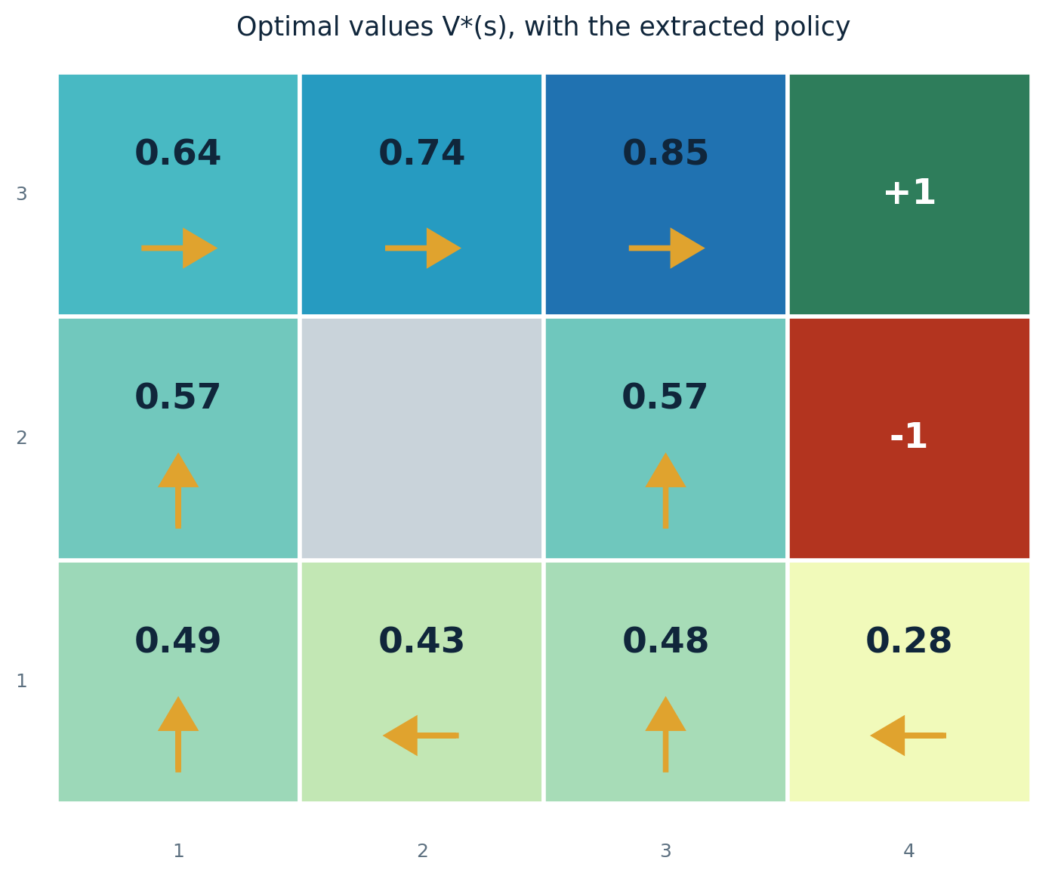
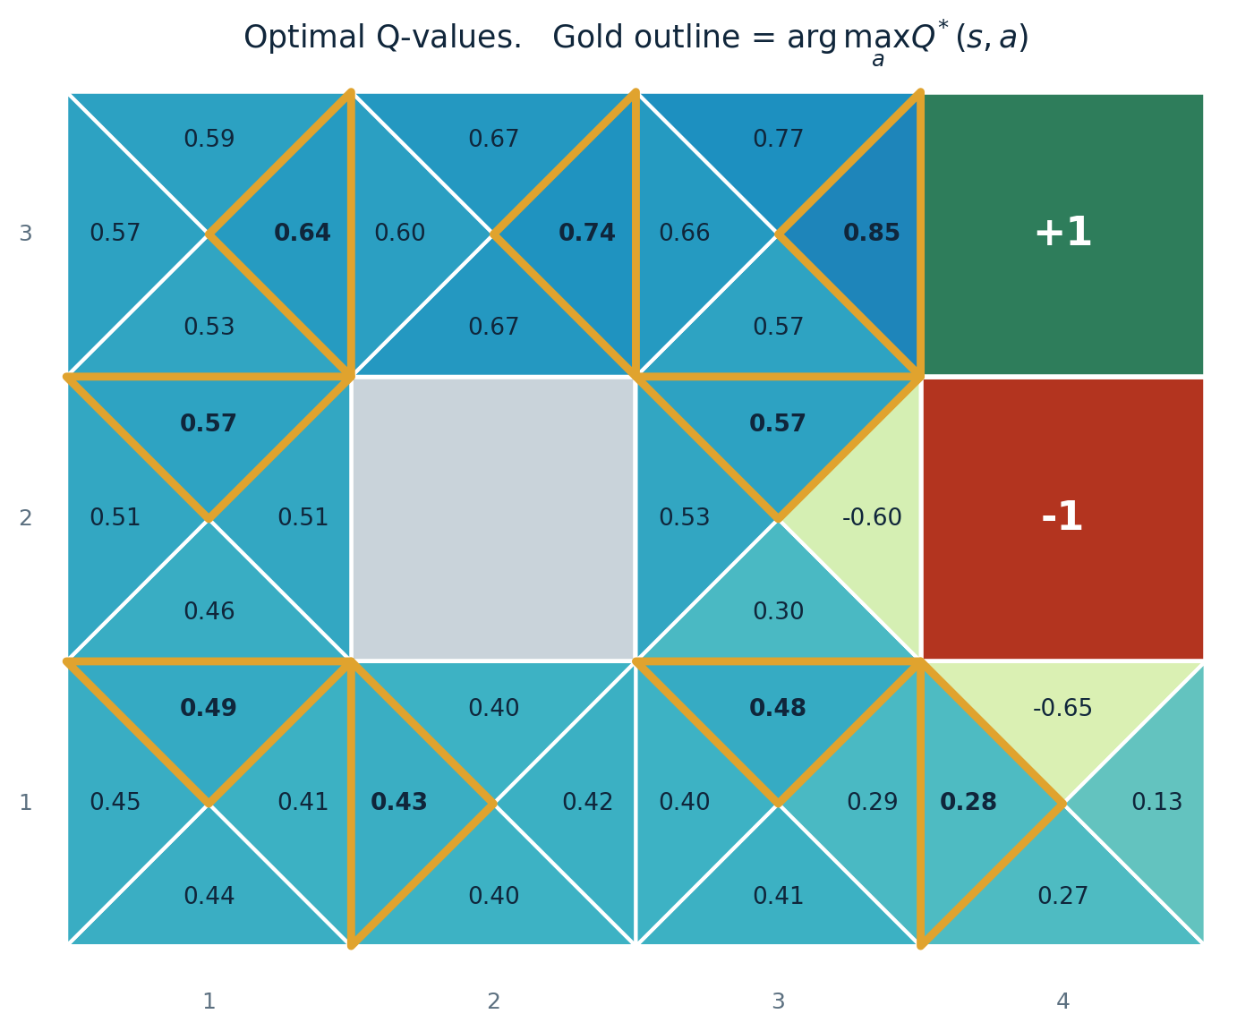
The same optimum, two ways to store it
Eleven numbers. To act, you still need T and R.
Thirty-eight numbers. To act, take the arg max.
Gridworld with noise 0.2, gamma 0.9, living reward 0. Q-values cost a factor of |A| more storage and buy you model-free action selection.
COMP 469 | Markov Decision Processes II
30
Notes:
Point at the square (3,2), just above the pit at (4,2). On the left, the value 0.57 tells you the situation is decent but says nothing about what to do. On the right, the gold outline says immediately: go Up. Its Q of 0.57 beats going East, which is -0.60 because East risks the pit. That -0.60 is worth calling out. It is the only strongly negative Q-value in the top rows, and it encodes exactly the danger a value function hides from you. Do the counting aloud: nine non-terminal states with four actions plus two exits gives thirty-eight Q-values, against eleven values. Four times the storage, and it buys you the ability to act without a model. These numbers are the ones from the Berkeley demo; I regenerated them rather than copying, so they should agree exactly if students run the gridworld code themselves.

Slide 31
Checkpoint
Write it down before you look at the next slide
Without looking: write the Bellman equation for V*(s). Then read it out loud in English, one term at a time.
1
A student writes V*(s) = max over a of T(s,a,s')[R + gamma V*(s')] with no summation. What did they lose, and when would their version accidentally be correct?
2
In gridworld, Q*((3,2), East) = -0.60 while V*((3,2)) = 0.57. Explain how both can be true at once.
3
COMP 469 | Markov Decision Processes II
31
Notes:
Answers to have ready: 1. Reward now, plus discounted future, averaged over outcomes, maximized over actions. Insist on the ordering: the max is outside, the sum is inside. Swapping them is a different and wrong equation. 2. They lost the expectation over outcomes - the equation as written is not even well formed, because s-prime is a free variable. Their version would be correct only in a deterministic MDP, where each action has a single outcome with probability 1. That is a nice observation in its own right: in the deterministic case the Bellman equation degenerates into ordinary shortest-path relaxation. 3. Q* is the value of committing to East and then playing optimally. East from (3,2) risks slipping into the pit, so it is a bad commitment. V* is the max over actions, and the max is achieved by Up at 0.57. A state can be fine while a particular action from it is terrible.

Slide 32
04
Reward Scales and Representation
Affine transformations
The shaping theorem
Potentials
Tables, DDNs, and why Tetris is hard
AIMA 17.1.3 - 17.1.4 | How much freedom do we have in writing rewards?
COMP 469 | Markov Decision Processes II
32

Slide 33
The scale of utilities is arbitrary
From Chapter 16: an affine transformation of utilities leaves every decision unchanged.
U'(s) = m U(s) + b
R'(s,a,s') = m R(s,a,s') + b
for any constants m > 0 and b
the same freedom, applied to rewards
Why this is obvious once you see it
Scaling every utility by a positive constant cannot change which one is largest, and adding a constant to all of them shifts them together. An arg max is blind to both. So the optimal policy is identical - only the printed numbers move.
This is the formal reason the convention trap earlier was harmless
Moving from the R(s) convention to the R(s,a,s') convention shifted every non-terminal utility by exactly -0.04. That is b = -0.04 with m = 1. Different numbers, identical policy. Now we ask a much more interesting question: is an affine map the only freedom we have?
COMP 469 | Markov Decision Processes II
33
Notes:
Short slide, mostly setup. The affine invariance result is inherited from Chapter 16 and students should already accept it. The genuinely useful move is the callback to the convention slide. They saw two tables of numbers differing by 0.04 and were told the policies agree; now they know why, and it is a one-line argument. End on the question, because the answer is no - the additive decomposition of utility into rewards gives us substantially more freedom than a plain affine map. That is the shaping theorem.

Slide 34
The shaping theorem
Let Phi(s) be any function of the state whatsoever. Then this transformation leaves the optimal policy unchanged:
R'(s,a,s') = R(s,a,s') + γ Φ(s') - Φ(s)
AIMA equation 17.9
Sketch of the proof
Why the name potential
Define Q'(s,a) = Q(s,a) - Phi(s) and substitute into the Bellman equation for Q.
The Phi terms telescope, and what survives is exactly the Bellman equation for the shaped MDP.
So Q' is the Q-function of M'. Extract the policy with equation 17.7:
argmax of [Q(s,a) - Phi(s)] equals argmax of Q(s,a), because Phi(s) does not depend on a.
Phi is called a potential, by analogy with electrical potential. The term gamma Phi(s') minus Phi(s) acts as a gradient of that potential.
If Phi is larger in states with higher utility, then adding this term rewards the agent for moving uphill in utility - without changing what optimal means.
Sanity check: every policy is optimal when the reward is zero everywhere. So by the theorem, every policy is optimal under a purely potential-based reward.
COMP 469 | Markov Decision Processes II
34
Notes:
This is the deepest result in 17.1 and it is worth the time. The claim is startling: you may add an essentially arbitrary state-dependent term to the reward, and the optimal policy does not move at all. For the intuition, take gamma = 1. Along any path from A to B the shaping terms telescope: Phi(s1)-Phi(s0), then Phi(s2)-Phi(s1), and so on, collapsing to Phi(B) - Phi(A). That depends only on the endpoints, so every route between A and B is affected identically and no route is preferred. Adding a path-independent quantity cannot reorder paths. The proof sketch on the left is fully in the book; do not grind through the algebra unless the room wants it. The key line is the last one: Phi(s) does not depend on a, so it slides out of the arg max. This result is the theoretical license behind reward shaping in modern RL, and knowing it is what separates principled shaping from the kind that quietly changes the problem.

Slide 35
Shaping in practice, and the catch
Set Phi(s) = U(s) and something remarkable happens: the greedy policy on the shaped reward is already optimal.
There is no free lunch
π_{G}(s) = argmax_{a} Σ_{s'} P(s'|s,a) R'(s,a,s')
To set Phi = U you would have to already know U - which is the thing you were trying to compute.
= argmax_{a} Σ_{s'} P(s'|s,a) [ R(s,a,s') + γU(s') - U(s) ]
= argmax_{a} Σ_{s'} P(s'|s,a) [ R(s,a,s') + γU(s') ]
But there is still real value in making the reward reflect what you want, as far as you can. A rough guess at U is still a useful Phi.
= π*(s)
This is exactly what animal trainers do when they give a treat for each step of a target sequence.
The third line drops U(s) because it is a constant with respect to a. The last line is just equation 17.4.
Engineering warning. Shaping is safe only in the potential-based form above. Bonus rewards invented on intuition - two points for moving toward the goal, say - are usually not potential-based, and they change the optimal policy. That is how you get an agent that learns to circle the goal collecting progress bonuses instead of finishing.
COMP 469 | Markov Decision Processes II
35
Notes:
The derivation is four lines and worth walking. The only trick is that U(s) has no dependence on a, so it leaves the arg max untouched. The no-free-lunch point is important intellectually but the practical message is the one on the right: a decent approximation to U makes a decent potential, and shaped rewards let a learner find good behavior much faster. Spend real time on the warning box - it is the part they will actually use. Hand-designed bonus rewards that are not potential-based silently redefine the task. The classic failure is a robot rewarded for reducing distance to a goal that learns to oscillate, harvesting the reduction term over and over. The theorem tells you the safe shape; anything else requires you to prove the policy did not move. Connect it forward: this is a live issue in RL from human feedback, where proxy rewards are shaped constantly.

Slide 36
Representing MDPs: when the tables stop fitting
AIMA 17.1.4
Atomic: big tables
Factored: DDNs
Tetris
Store P and R as three-dimensional tables of size |S| squared times |A|.
Extend dynamic Bayesian networks with decision, reward, and utility nodes to get dynamic decision networks. State becomes a set of variables; each action variable touches only a few of them.
Current piece, next piece, and one bit per board cell:
7 x 7 x 2²⁰⁰ ≈ 10⁶²
11² x 4 = 484
entries each, for the 4 x 3 world. Fine. Often sparse, giving O(|S||A|).
states. No table will ever hold this. And yet every Tetris policy is proper - the board fills eventually.
The robot that charges itself
The trick worth remembering
State decomposes into location and orientation X, its rate of change, a Charging flag, and a Battery level 0 to 5. Actions decompose into Plug/Unplug, LeftWheel power, and RightWheel power. The MDP's state and action spaces are the Cartesian products.
Project the network a few steps forward, then cap the horizon with a utility node instead of expanding further. A heuristic estimate of U stands in for the entire remaining future - exactly the bounded-depth search with an evaluation function we used for games in Chapter 5.
COMP 469 | Markov Decision Processes II
36
Notes:
Purpose of this slide: puncture the illusion that MDPs are small. Everything we do today assumes we can loop over all states. That assumption dies quickly. The 484-entry table for a 4 x 3 grid is a good anchor - trivial. Then Tetris at 10 to the 62 makes the point that you cannot even enumerate the state space, let alone store a value for each state. Factored representations are the standard answer, and note the phrasing from Chapter 2: DDNs are factored, tables are atomic, and factored representations typically give an exponential advantage. The bounded-horizon-plus-utility-node trick is the direct bridge to approximate methods and to the depth-limited search we did for games. It is also a preview of function approximation in deep RL: replace the table with something that generalizes. The Tetris properness remark is a nice aside: every policy reaches a terminal state, because the board fills up despite your best efforts.

Slide 37
05
Value Iteration
Time-limited values
The algorithm
A worked example
Complexity
Convergence, error bounds, and when to stop
AIMA 17.2 | From characterizing the answer to computing it
COMP 469 | Markov Decision Processes II
37

Slide 38
Characterize, then compute
The Bellman equations characterize
Value iteration computes
V*(s) = max_{a} Σ_{s'} T(s,a,s')[R(s,a,s') + γV*(s')]
V_{k+1}(s) ← max_{a} Σ_{s'} T(s,a,s')[R(s,a,s') + γV_{k}(s')]
An equality. A condition the answer must satisfy. Says nothing about how to find it.
An assignment, and a subscript. Almost the same glyphs, completely different object: a procedure that produces a sequence of approximations.
Two changes, and only two: the equals sign becomes an arrow, and subscripts appear.
Value iteration is a fixed-point method. You have a system of equations you cannot solve directly, so you apply an operator that takes a wrong answer and drags it toward the right one, and you keep applying it. The V-k vectors are also interpretable in their own right - and that interpretation is what makes the algorithm easy to remember.
COMP 469 | Markov Decision Processes II
38
Notes:
The two equations on this slide differ by almost nothing typographically and by everything conceptually. Say that explicitly, because students conflate them constantly on exams - they will write an assignment when asked for the Bellman equation and vice versa. Fixed-point framing: we have a system we cannot solve in closed form because of the max, so we iterate an operator with the property that its fixed point is the solution we want. Tease the next slide. Strictly speaking you do not need to know what V-k means to run the algorithm, but knowing it makes correctness obvious and makes the algorithm impossible to forget.

Slide 39
The key idea: time-limited values
V-k(s) is the optimal value of s if the game ends in exactly k more time steps.
Equivalently: V-k(s) is what a depth-k expectimax search from s would return.
V₀
Zero steps left. You collect no more rewards, so the sum is zero, for every state. Obviously correct and completely useless - which is exactly what you want from a base case.
V₁
One more reward. From a gridworld exit square you can take the exit and collect it. From anywhere else you collect only the living reward.
V_{k}
k more rewards, played optimally over that horizon. Note that a depth-k expectimax solves this exactly - the game genuinely ends at depth k, so there is nothing to approximate.
COMP 469 | Markov Decision Processes II
39
Notes:
This is the conceptual heart of value iteration, so do not rush it. So far, the value of a state has meant the expected score from acting optimally forever. A time-limited value asks a smaller question: what if the world ends in k steps? That smaller question has an easy answer. A depth-k expectimax solves it exactly - maybe slowly, but exactly - because the tree genuinely bottoms out. So we already have an algorithm for V-k. The rest of value iteration is just computing V-k efficiently by reusing V-(k-1). The unit of k is rewards, not moves. A one-step game gives you exactly one R(s,a,s'). Students get this wrong by one all the time. Note the honest caveat for advanced students: under the R(s) convention the indexing shifts slightly. Stay in one convention.

Slide 40
The value iteration algorithm
1. Initialize
One implementation note
V₀(s) = 0 for all s
We build a fresh copy of V each round, reading only from the previous copy. Many textbooks update a single vector in place.
No time steps left means an expected reward sum of zero.
2. Repeat, for every state s
V_{k+1}(s) ← max_{a} Σ_{s'} T(s,a,s') [ R(s,a,s') + γ V_{k}(s') ]
In-place still converges - often faster - but you lose the clean claim that V-k is the k-step lookahead value, because some entries are already partly updated.
One ply of expectimax from each state. Whenever the computation asks for V-k, look it up - you computed it last round.
For this course: use two copies, so your V-k means what we say it means.
3. Stop
when the values stop moving by more than your tolerance. A precise stopping rule comes in a few slides.
The rewards you can collect in k+1 steps are the reward you collect on the next step, plus the rewards you can collect in the remaining k - which you have already computed.
COMP 469 | Markov Decision Processes II
40
Notes:
Frame this as dynamic programming from the bottom up. Compute V-0 for all states, then V-1 using V-0, then V-2 using V-1. Each blue state in the expectimax tree recurs many times, so caching is the whole point - we compute V-k for a state once, not once per tree path. The italic sentence at the bottom is the recurrence in English. Have them repeat it back. The two-copy note matters for the homework autograder. In-place updates (Gauss-Seidel style) converge and are often faster, but then V-k is no longer the depth-k expectimax value and their intermediate outputs will not match the expected ones. Tell them plainly to use two copies. If a student asks whether the initialization matters: V-0 = 0 is the natural choice because it makes V-k exactly the k-step value. Value iteration converges from any bounded initialization, but you lose the interpretation.

Slide 41
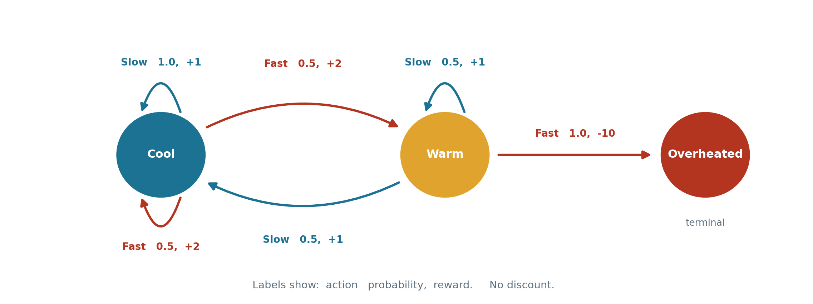
Worked example: the racing car
Three states, two actions, no discount. Go Fast and you earn more per step but risk overheating; go Slow and you are safe.
V-0
Cool 0 Warm 0 Overheated 0
From Cool with one step left: Fast pays 2 wherever it lands, Slow pays 1. Take Fast. From Warm: Fast overheats for -10, so take Slow and collect 1. Overheated is terminal, so 0.
V-1
Cool 2 Warm 1 Overheated 0
COMP 469 | Markov Decision Processes II
41
Notes:
V-1 is easy because it is pure greedy: what can I collect on my very next turn, ignoring everything after? From Cool, Fast pays +2 on either outcome, Slow pays +1, so V-1(Cool) = 2. From Warm, Fast goes straight to Overheated for -10, so you take Slow for +1. Stress that where you land is irrelevant at V-1: the game ends immediately after, so the landing state contributes nothing. That is the whole reason V-0 = 0 makes the base case work. Overheated is terminal, so it stays 0 forever. Once you are there you are stuck. Ask them to predict whether V-2(Cool) will still prefer Fast before you turn the page.

Slide 42
Worked example: computing V-2 by hand
From Warm
From Cool
Fast sends you to Overheated for -10 and the game is over. Not the max - skip the arithmetic. Slow splits 50/50:
Slow: 1.0 [ 1 + V-1(Cool) ] = 3. Fast splits 50/50 between Cool and Warm, paying 2 either way:
0.5 [ 1 + V₁(Warm) ] + 0.5 [ 1 + V₁(Cool) ]
0.5 ( 2 + 2 ) + 0.5 ( 2 + 1 ) = 3.5
= 0.5 ( 1 + 1 ) + 0.5 ( 1 + 2 ) = 2.5
Max of 3 and 3.5 is 3.5, so V-2(Cool) = 3.5 and the best action is still Fast.
So V-2(Warm) = 2.5.
Cool
Warm
Overheated
V-0
0
0
0
V-1
2
1
0
V-2
3.5
2.5
0
This is already tedious with three states. It is why we use computers - and why the complexity question is worth asking.
COMP 469 | Markov Decision Processes II
42
Notes:
Do this one on the board with the room, slowly. It is the single best inoculation against the equation feeling abstract. Start from Warm because it has the shortcut: Fast leads straight to Overheated for -10, which obviously will not win the max, so you can skip computing it. Tell them that skipping is legitimate here but that as an exercise they should compute it and confirm. Then Cool. The subtlety worth naming: both Fast outcomes pay +2 immediately, but they differ in where you land, and V-1(Cool) = 2 while V-1(Warm) = 1. So the average is 0.5(2+2) + 0.5(2+1) = 3.5. Students often forget that the future term differs across outcomes even when the immediate reward does not. If you have time, ask what V-3(Warm) would be - it starts to reveal that Fast from Cool becomes less attractive as the horizon grows, because overheating becomes a real risk.

Slide 43
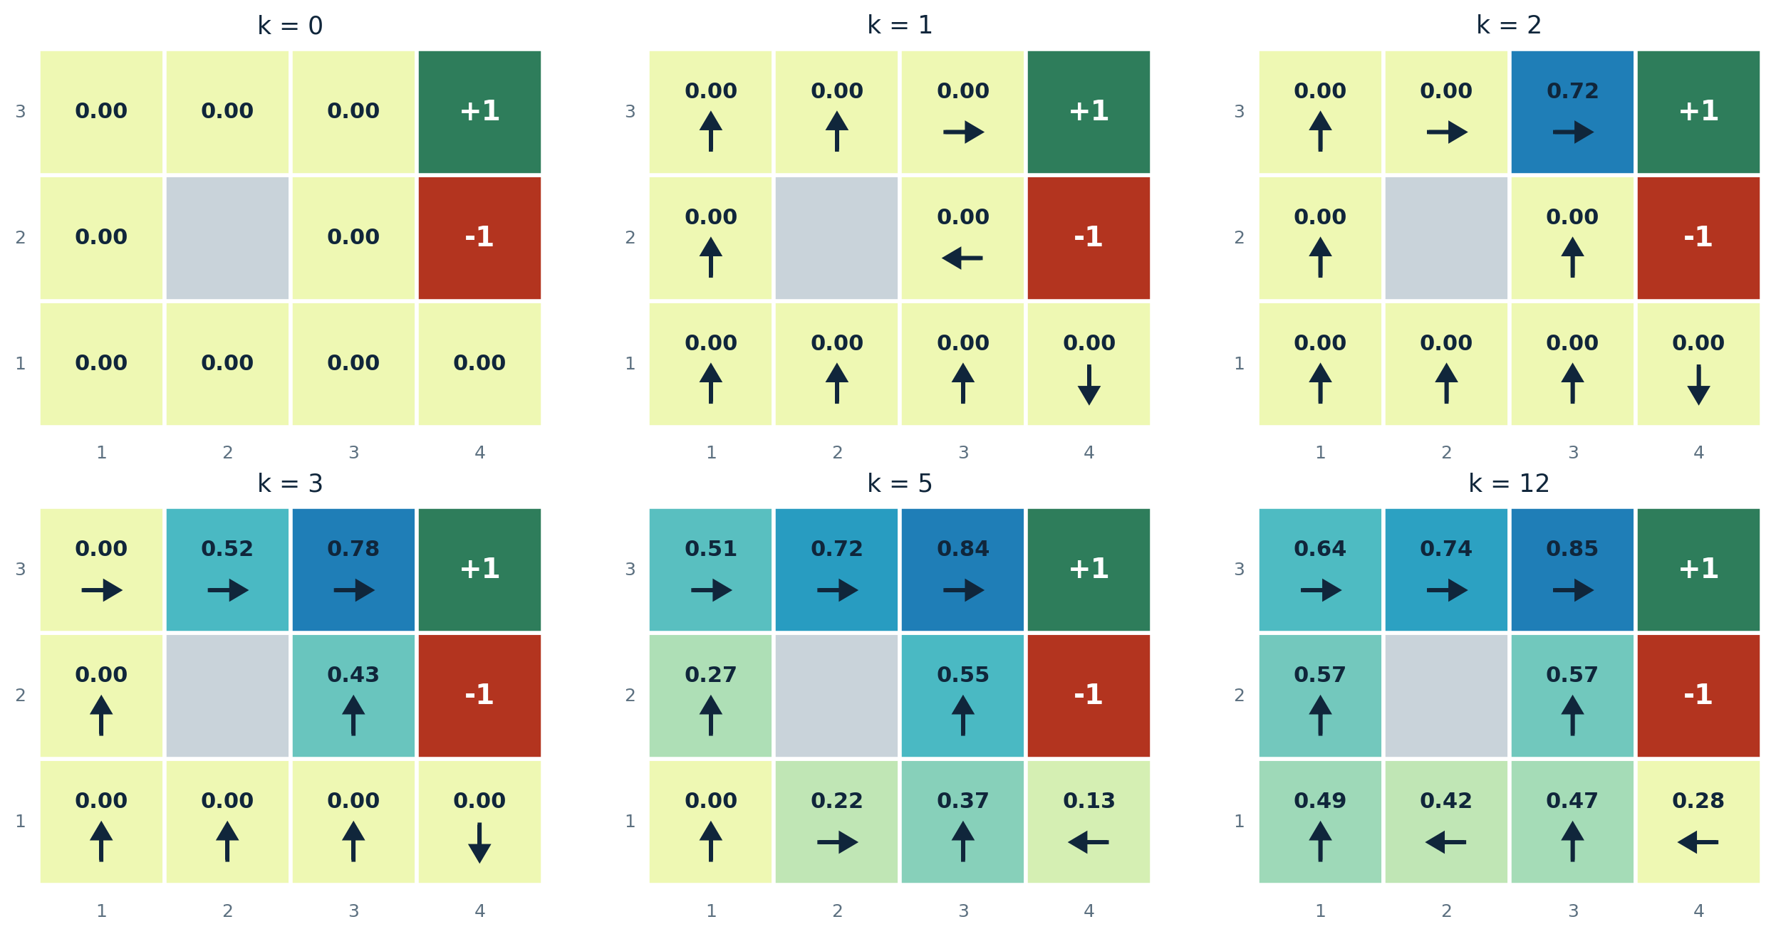
Value iteration in motion
Gridworld with noise 0.2, gamma 0.9, living reward 0. Values spread outward from the exits, and every value also keeps growing as longer trajectories fold in.
Two things are happening at once: reward information propagates one square further per sweep, and already-reached states keep rising as longer paths - slip, recover, succeed - become available within the horizon.
COMP 469 | Markov Decision Processes II
43
Notes:
Narrate the frames. At k=1 only the exit squares are non-zero, because with one reward left the only way to earn anything is to take an exit action. At k=2, the square west of the gem turns 0.72 - it can now reach the exit and take it. Ask about the square below the gem at k=2. It can reach the pit in two steps, but under optimal play it does not, so it stays at zero. That is a good check of whether they understand the max: bad options within the horizon do not lower a value, they are simply not chosen. The second effect is subtler and worth calling out. The 0.72 square does not stop at 0.72; it climbs toward 0.85 because longer trajectories - try, slip, recover, succeed - only fit inside a larger horizon. So values grow for two distinct reasons. Finally, have them watch the arrows across frames. Most sweeps change the numbers without changing any arrow. Park that observation - it is the entire motivation for policy iteration.

Slide 44
Complexity of one sweep
O( |S|² |A| ) per iteration
|S|
Outer loop
|A|
Action loop
|S|
Outcome loop
You must fill in a new value for every state, so one factor of |S| is unavoidable.
For each state you enumerate every action to find the max. This is the factor policy iteration will attack.
For each action you sum over possible successors. In principle |S|, but in practice this is the branching factor - in gridworld only three or four states are reachable.
The honest version: the second |S| is really the branching factor of the transition model. Sparse transitions are the normal case, and they are what make value iteration usable at all on real problems.
COMP 469 | Markov Decision Processes II
44
Notes:
Derive it live rather than asserting it. Ask: what do we loop over? Every state - that is |S|. For each, every action - that is |A|. For each action, every possible outcome - that is another |S| in the worst case. The nuance in the dark box is worth making. The two |S| factors are not the same kind of thing. The first is genuinely the size of the state space. The second is how many successors an action can have, which in gridworld is at most three or four regardless of how big the grid gets. If you store transitions sparsely, one sweep is closer to O(|S||A|b). Flag the |A| factor deliberately. In realistic MDPs the action space is large, and we will spend the next section removing that factor from most of the work.

Slide 45
Why does this converge at all?
Case 1: bounded depth
Case 2: the discount saves us
If the state space has a maximum depth M - the process simply cannot run longer than M steps - then V-M already holds the actual, untruncated values. Nothing is being approximated and we are done.
Usually there is no maximum depth and the process can run forever. Then we need gamma < 1 and bounded rewards. Here is the argument.
1
V-k and V-(k+1) are both expectimax over nearly identical trees. Same structure, same probabilities, same rewards.
| V_{k} - V_{k+1} | ≤ γ^{k} max|R|
2
The only difference is the bottom layer: V-(k+1) has real rewards down there, while V-k has zeros.
Gamma to the k goes to zero, so the differences vanish. The convergence is geometric, at rate gamma.
3
That last layer is at best R-max and at worst R-min - but either way it sits k steps out, so it is multiplied by gamma to the k.
If neither case holds - infinite horizon, no discount, unbounded accumulation - the values genuinely may not exist. The theorem is not being coy.
COMP 469 | Markov Decision Processes II
45
Notes:
The two-trees picture is the one that makes this click. Draw two triangles side by side. They are identical except at the very bottom: the left one has zeros where the right one has real rewards. Then ask: how different can they possibly be? At most the largest reward magnitude - but everything at that depth is discounted by gamma to the k. Push k out far enough and the difference is as small as you like. Two assumptions get used and both should be named: rewards are bounded, and gamma < 1. Neither is free. The last box is the intellectually honest bit. Students want a theorem that always applies. This one does not, because in the undiscounted infinite case the object being computed may not exist.

Slide 46
The sharper version: contraction and stopping rules
AIMA 17.2.1 | This is where the hand-wave becomes a proof
The Bellman operator is a contraction
So uniqueness comes free
|| B U - B U' ||∞ ≤ γ || U - U' ||∞
Earlier we said the Bellman equations characterize the optimal values, and asserted the solution is unique. This is the proof: a contraction on a complete space has one and only one fixed point. Both convergence and uniqueness fall out of the same inequality.
Applying one Bellman update to any two value vectors brings them at least a factor of gamma closer, in max norm. A contraction has exactly one fixed point, and iterating always reaches it.
Two practical consequences
N = ⌈ log( 2R_{max} / ε(1-γ) ) / log(1/γ) ⌉
if || V_{i+1} - V_{i} || < ε(1-γ)/γ then || V_{i+1} - V* || < ε
iterations needed to guarantee error below epsilon
the stopping rule you can actually check at runtime
Note the (1 - gamma) in both denominators. As gamma approaches 1 the required iteration count blows up - which is exactly the gamma = 0.99 curve you saw flattening out on the convergence plot.
COMP 469 | Markov Decision Processes II
46
Notes:
This is the rigorous version of the previous slide, and it is the part that shows up on the exam as a short-answer question: why does value iteration converge? Answer: the Bellman operator is a gamma-contraction in the max norm. Contraction in one sentence: take any two guesses at the value function, apply one Bellman backup to each, and the worst-case gap between them shrinks by at least a factor of gamma. Since the true V* is itself a fixed point, your error to V* shrinks by gamma every sweep. Uniqueness is the bonus. We asserted it forty minutes ago; here it is earned. The second formula is the operationally useful one, because you cannot measure your distance to V* - you do not have V*. You can measure how much the values moved last sweep, and that bounds your true error. Point out the gamma over one-minus-gamma amplification: near gamma = 1, a tiny observed change can still hide a large real error.

Slide 47
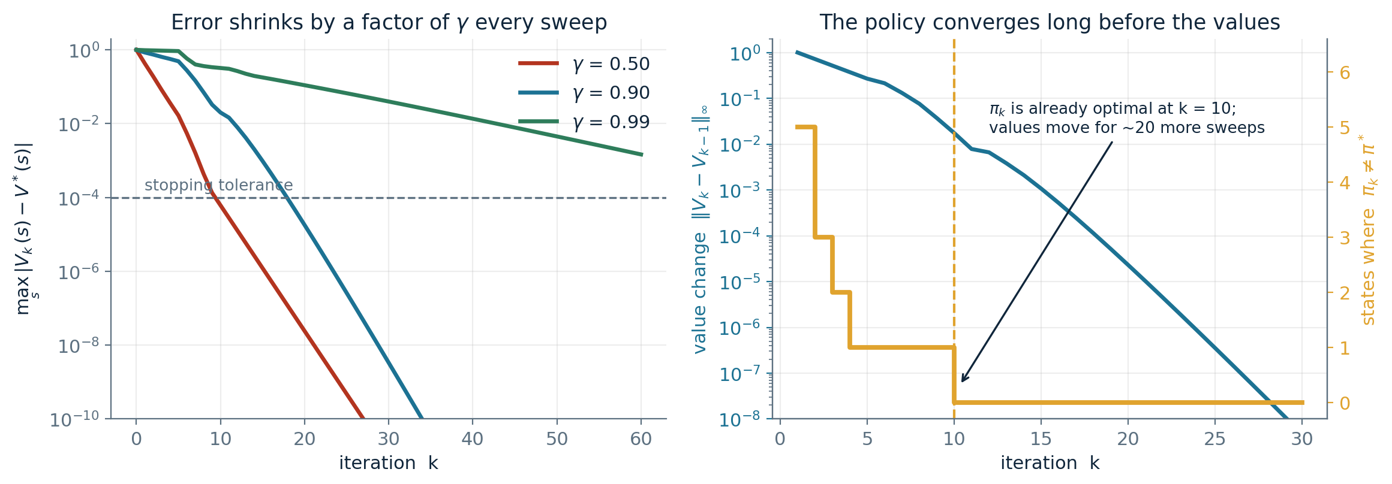
Values converge slowly; policies converge fast
Left: error against V*, log scale, three discount factors. Right: value movement versus the number of states where the greedy policy still disagrees with pi*.
You do not need exact values to rank actions. Being roughly right about every state is usually enough to know which action wins.
|| V_{i} - V* || < ε ⇒ policy loss < 2εγ / (1-γ)
COMP 469 | Markov Decision Processes II
47
Notes:
The right panel is the pedagogical payoff of the whole section. At gamma = 0.9 the greedy policy is already optimal at iteration 10, while the values keep moving measurably for another twenty sweeps. That gap is pure wasted work if all you wanted was a policy - and a policy is almost always all you wanted. Values are a means. The bound on the right formalizes what we care about: policy loss is how much worse you do by executing the greedy policy on your approximate values instead of the true optimal policy. Small value error implies small policy loss, with that same one-minus-gamma amplification. This observation is the direct motivation for the next section. If the arg max stops changing long before the numbers settle, why are we recomputing the arg max over all actions on every single sweep?

Slide 48
06
Policy Methods
Fixing a policy simplifies everything
Policy evaluation
Policy extraction from V and from Q
Policy iteration
An honest comparison
AIMA 17.2.2 | Evaluate a policy, extract a policy, improve a policy
COMP 469 | Markov Decision Processes II
48

Slide 49
What happens when you fix the policy
Do the optimal action
Do what pi says to do
s
s
a
π(s)
s, a
s, π(s)
s, a, s'
s, π(s), s'
s'
s'
Branching factor |A| at every max node. You evaluate every action, every time.
Branching factor 1 at every action node. The chance nodes are untouched - the world is still stochastic.
Fixing the policy removes one entire for-loop. It does not remove the uncertainty - you still do not know where you will land.
COMP 469 | Markov Decision Processes II
49
Notes:
Compare the two trees explicitly. On the left, at each state we branch over all actions and take a max. On the right there is nothing to choose: the policy names the action, so the action layer has branching factor one. The thing students get wrong: they assume fixing the policy makes everything deterministic. It does not. The chance nodes are identical on both sides. You still slip 20 percent of the time; you just no longer get to deliberate about it. The cost saving is a clean factor of |A| per sweep, and the tree's value is no longer V* - it is V-pi, the value of that specific, probably mediocre policy. Both facts matter for what comes next.

Slide 50
Utilities for a fixed policy
V-pi(s) is the expected total discounted reward starting in s and following pi thereafter. Its Bellman equation has no max:
V^{π}(s) = Σ_{s'} T(s, π(s), s') [ R(s, π(s), s') + γ V^{π}(s') ]
Turn the equality into an assignment and you have an algorithm:
V^{π}₀(s) = 0
Cost
O( |S|² ) per iteration
V^{π}_{k+1}(s) ← Σ_{s'} T(s,π(s),s')[R + γ V^{π}_{k}(s')]
The |A| factor is gone. On problems with large action spaces this is a very large saving per sweep.
The catch: policy evaluation is much faster than value iteration, and it solves a different problem. It tells you how good pi is. It does not tell you how good you could be. On its own that is not what we want - but as a subroutine it is about to become extremely useful.
COMP 469 | Markov Decision Processes II
50
Notes:
Emphasize how mechanical the derivation is. Take the Bellman equation, delete the max, replace a with pi(s) everywhere it appears - including inside R and T. That is the entire modification. Students will ask whether the policy has to be good. No. Evaluate a terrible policy and you get small numbers, correctly computed. That generality is the point. The cost analysis is a nice payoff from the complexity slide earlier: we identified the |A| loop as the target, and here it is gone. Land the catch. Policy evaluation answers the wrong question, quickly. Policy iteration will be about calling it repeatedly on a sequence of improving policies.

Slide 51
Or skip the iteration entirely
Stare at the policy evaluation equations and forget for a moment that this is AI.
What are the unknowns?
The values V-pi(s), one per state.
Which should you use?
Small |S|: solve exactly. It is one call, no tolerance to tune, and the answer is exact.
Large |S|: cubic is unacceptable and the iterative version is cheap per sweep. Iterate.
Very large |S|: do not run either to convergence. Take a fixed number of sweeps - this is modified policy iteration, later this section.
How many equations?
One per state. So |S| equations in |S| unknowns.
What kind of equations?
Linear. Every term is a constant times some V-pi(s'), plus a constant.
So use linear algebra
Solve it exactly with your favourite solver in O(|S|^3). The only thing that was ever stopping us from doing this to the Bellman equations was the max, which is nonlinear. Remove the max and standard tools apply.
COMP 469 | Markov Decision Processes II
51
Notes:
Run this slide as a question to the room, the way the Berkeley lecture does. Put the equations up, tell them to forget it is AI, and ask what the unknowns are. Someone will say it: this is just a linear system. Then make the connection back. The reason we could not do this to the original Bellman equations is the max - it is nonlinear, and no linear solver will touch it. Fixing the policy removed the max, and the moment it is gone, decades of numerical linear algebra become available. This is a nice moment to note that a lot of algorithmic progress looks like this: not a new idea, but recognizing that after one simplification your problem is a problem someone else already solved. Cubic cost is the practical limit; for a few thousand states it is fine, beyond that iterate.

Slide 52
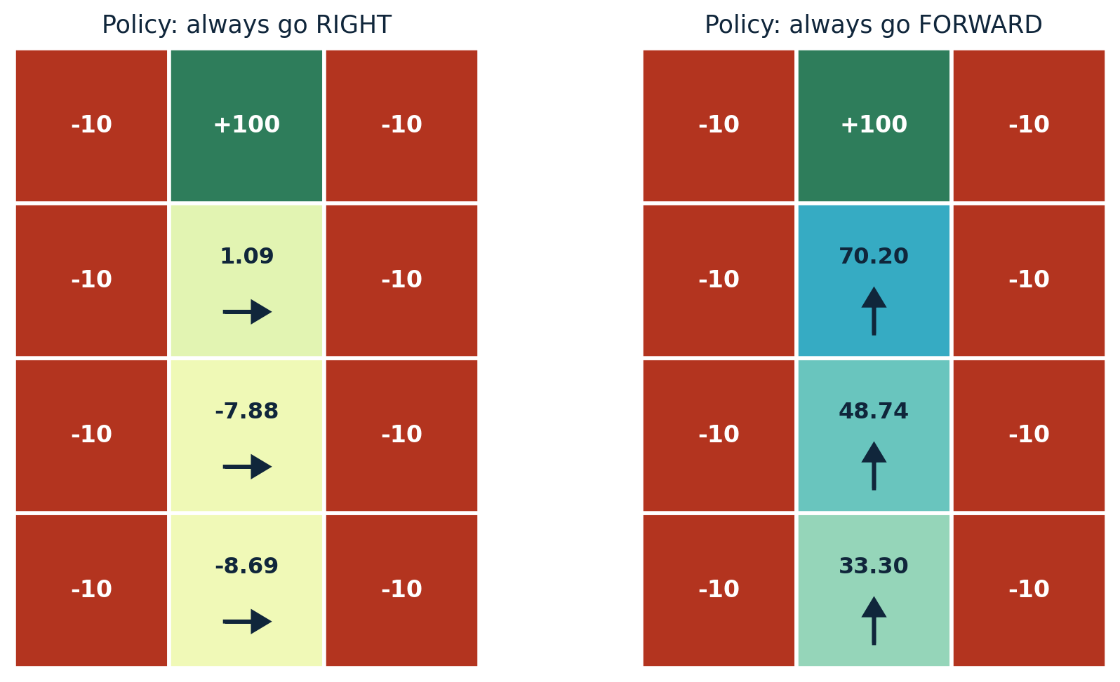
Example: evaluating two policies
Reading the numbers
Always-right walks into the fire from almost everywhere, so its values are near zero or negative.
Always-forward marches up the corridor to the +100, and its values climb 33, 49, 70 as you get closer.
Policy evaluation did not judge either one. It reported what each is worth. Comparing them is our job, and that is the next step.
The same corridor, the same dynamics, two different fixed policies. Both evaluations are correct; only one policy is any good.
COMP 469 | Markov Decision Processes II
52
Notes:
Good slide for a quick prediction exercise: before showing the numbers, ask which squares will be negative under always-right and why. Always-right: from the middle column the intended move takes you into fire. The 20 percent noise occasionally saves you by pushing you up or down instead, which is why the top cell manages a slightly positive 1.09 - it can sometimes stumble into the +100 before the fire gets it. Always-forward is essentially optimal here, and the values decay by roughly gamma per step as you move away from the goal. Ask them to check that 70.20 times 0.9 is about 63, and the next value down is 48.74 - not quite gamma, because noise costs you. The framing in the box is the important one: evaluation is descriptive, not prescriptive.

Slide 53
Policy extraction: from values to actions
Somebody hands you the optimal values V*. How should you act?
It is not obvious. Values tell you which states are good, but you do not control which state you are in - you control your action. And knowing that the square to the north is valuable does not tell you that North is the best action, because North might slip you into a pit.
Remember this from the r-ranges figure
Sometimes the right action was to head into a wall on purpose, so that both slip directions were safe.
You have to do a one-step expectimax, using the values you were given as the leaf evaluations:
π*(s) = argmax_{a} Σ_{s'} T(s,a,s')[ R(s,a,s') + γ V*(s') ]
No amount of staring at a grid of values will reveal that. It depends on the noise model and on where the neighbours lead.
AIMA equation 17.4
Values tell you how good your situation is. They do not tell you what to do.
Same one-step lookahead as always. The only difference is that argmax returns the action that achieved the maximum, rather than the value of the maximum.
COMP 469 | Markov Decision Processes II
53
Notes:
Make them feel the difficulty before giving the formula. Put up a grid of values, point at a square, and ask what to do. Someone will say go toward the biggest neighbour. Then remind them of the wall-hugging behaviour from the r-ranges figure, where the optimal action pointed at a wall. The reason is that you cannot move to a state, you can only take an action, and the mapping from actions to states is stochastic. Evaluating that mapping is exactly the one-step expectimax. For students who have not seen argmax notation, define it here: max returns the largest value, argmax returns the argument that produced it. Here that argument is an action. Note this requires knowing T and R. That requirement is what the next slide removes.

Slide 54
Policy extraction from Q-values is trivial
π*(s) = argmax_{a} Q*(s, a)
That is the whole thing. No sum, no transition model, no reward function, no discount. Look at the numbers attached to your state, take the biggest, do that action.
Why this is a big deal
Extracting a policy from V requires a model. Extracting it from Q does not. If you are going to learn something from experience rather than be handed it, learn Q. This insight is a large part of what unstuck reinforcement learning, and it is where we pick up next week.
COMP 469 | Markov Decision Processes II
54
Notes:
This is the payoff for the asymmetry we planted an hour ago. Put the two extraction formulas side by side mentally: one has a sum over successors, a transition function, a reward function, and a discount. The other has an arg max over a handful of numbers. Say plainly why it matters. In reinforcement learning you do not have T or R - that is the definition of the setting. So a learned value function is not directly actionable, while a learned Q-function is. The Berkeley framing is worth repeating: this was the key thing that held reinforcement learning back for a long time, and Q-values also come with a further non-obvious property - you can learn optimal Q-values from non-optimal behaviour. That is off-policy learning, and it is next week's headline. Cost: Q-values need |A| times the storage. Worth it.

Slide 55
Policy iteration
We noticed that the arg max rarely changes between sweeps. So stop recomputing it every time.
Start
Take any policy pi-0. It can be arbitrary - always go right, always go north, whatever. It will be bad.
Why it is correct
1
Each improvement step produces a policy at least as good as the last, and strictly better unless it is already optimal.
There are finitely many policies - at most |A| to the |S|, which for our nine-state gridworld is 4^9 = 262,144.
A strictly increasing sequence over a finite set must terminate. So policy iteration halts, at an optimal policy.
It is still exact. Nothing is approximated away.
Evaluate
Run policy evaluation on the current policy until its values converge. These are the true values of a mediocre policy, not the optimal values. Cheap: no |A| factor.
2
Improve
Run policy extraction once, using those values. Here we do check every action again - this is the expensive step, and we do it rarely.
3
Repeat
Until the policy stops changing. When an improvement step returns the policy you already had, you are done.
4
COMP 469 | Markov Decision Processes II
55
Notes:
Motivate it from the animation they already saw: the numbers changed every sweep, the arrows almost never did. Value iteration spends an |A| factor on every state on every sweep re-confirming a decision that has not changed in twenty iterations. Policy iteration flips the loop. Freeze the policy, evaluate it cheaply and thoroughly, then spend the expensive full max exactly once, and freeze again. The termination argument is genuinely elegant and worth spelling out. The space of policies is finite. Each improvement strictly increases value unless we are at a fixed point. You cannot strictly increase forever in a finite set. Therefore we stop, and we stop at a policy no improvement step can beat - which by the Bellman equation is optimal. The 262,144 figure makes finiteness concrete without making it sound small.

Slide 56
Policy iteration, in equations
Evaluation: for the current policy pi-i, iterate until the values converge
V^{π_{i}}_{k+1}(s) ← Σ_{s'} T(s, π_{i}(s), s') [ R(s, π_{i}(s), s') + γ V^{π_{i}}_{k}(s') ]
Improvement: one-step lookahead, run exactly once, with the max restored
π_{i+1}(s) = argmax_{a} Σ_{s'} T(s,a,s') [ R(s,a,s') + γ V^{π_{i}}(s') ]
Look at what is actually different
Both lines are the same one-step lookahead we have been writing since the start of the lecture. The first has no max and a subscript counting sweeps. The second has a max, is an argmax rather than a max, and changes the policy index rather than the sweep index. That is the entire difference between evaluation and improvement.
COMP 469 | Markov Decision Processes II
56
Notes:
Put both equations up and ask the room to spot the differences before you narrate them. There are exactly three: presence of the max, argmax versus max, and which index is being advanced. Note the asymmetry in how often each runs. Evaluation runs many times per round - possibly dozens of sweeps - because we want converged values for the fixed policy. Improvement runs once per round. Flag for the homework: students often forget to use the converged V-pi-i in the improvement step and instead use whatever V they had lying around. That still often works, and in fact truncating evaluation deliberately is a legitimate variant, which is the next slide.

Slide 57
Two variants worth knowing
AIMA 17.2.3 | Because the pure versions are rarely what you run in practice
Modified policy iteration
Asynchronous value iteration
Do not run policy evaluation to convergence. Run it for a fixed small number of sweeps - often just a handful - then improve.
Nothing requires you to update every state on every sweep. Pick any subset and update those.
Why it works: you never needed exact values for the current policy. You only needed values good enough to rank actions correctly at the next improvement step.
It still converges, provided every state is updated infinitely often. That is a remarkably weak condition.
Which lets you be strategic: prioritized sweeping updates the states whose values just changed the most, and states that are irrelevant under any decent policy can be largely ignored.
With one evaluation sweep this is essentially value iteration; with infinitely many it is policy iteration. The useful settings live in between.
Both variants exist for the same reason: the textbook algorithms do a lot of work whose result was already known. Recognizing that pattern is most of what algorithm engineering is.
COMP 469 | Markov Decision Processes II
57
Notes:
Modified policy iteration is what most real implementations actually run, so it deserves the airtime. The insight is that exact evaluation of a policy you are about to throw away is wasted precision. The spectrum framing is the memorable bit: one evaluation sweep gives you value iteration, full convergence gives you policy iteration, and everything useful is in the middle. It reframes the two algorithms as two ends of one family rather than as rivals. Asynchronous VI matters for large state spaces where a full sweep is already prohibitive. The convergence condition - every state updated infinitely often - is weak enough to permit aggressive prioritization. Mention prioritized sweeping by name; students will meet it again. Connect to reachability: in a huge MDP, most states are unreachable under any reasonable policy, and asynchronous methods let you ignore them.

Slide 58
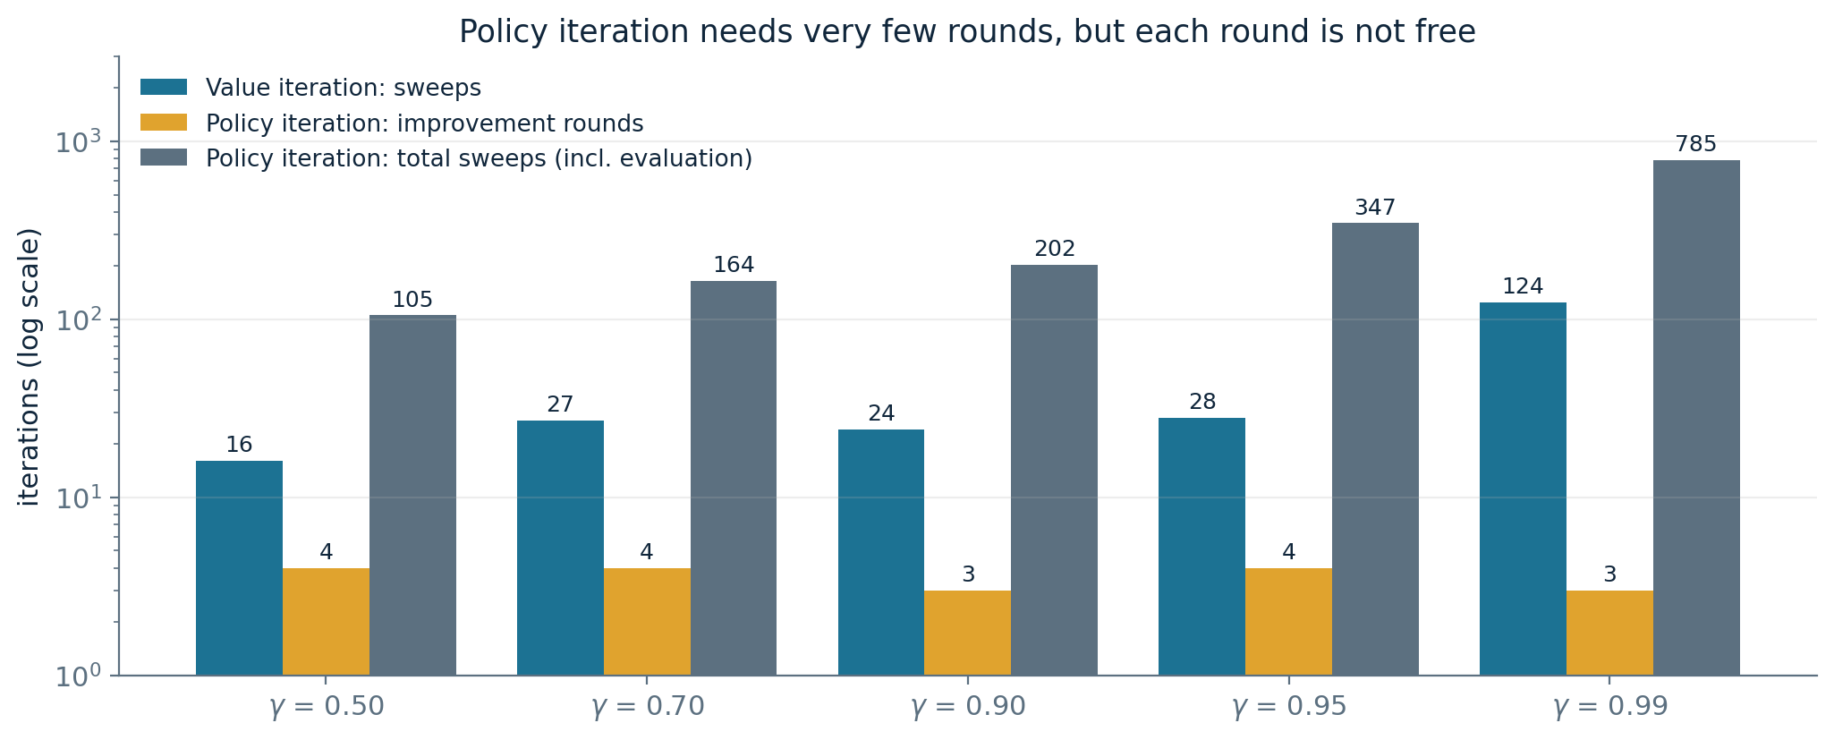
Value iteration versus policy iteration
Same 4 x 3 gridworld, five discount factors, log scale. Policy iteration converges in three or four rounds regardless of gamma - but each round contains a full policy evaluation.
Read this carefully. The usual claim is that policy iteration is much faster. On rounds, that is dramatically true. On total Bellman sweeps it is false here, because I ran evaluation to full convergence. Policy iteration wins when you solve the linear system exactly, or when you truncate evaluation - which is why modified policy iteration exists.
COMP 469 | Markov Decision Processes II
58
Notes:
I deliberately did not draw the flattering version of this chart. The standard slide shows rounds only and implies policy iteration is a strict win, which is not honest when evaluation is iterative. Two real takeaways. First, the round count for policy iteration is almost independent of gamma - three or four at every setting - while value iteration degrades badly, from 16 sweeps at gamma 0.5 to 124 at gamma 0.99. That insensitivity is the genuine structural advantage. Second, a round is not free. If you evaluate iteratively to full convergence you can easily do more total work than plain value iteration. The fixes are exact linear solves for small state spaces, or truncated evaluation for large ones. Good exam-style question to pose: under what conditions would you expect policy iteration to win decisively? Large |A|, moderate |S| so the cubic solve is affordable, gamma close to 1.

Slide 59
Summary: four tools, one equation
Compute optimal values
Value iteration or policy iteration
max over actions, iterate to a fixed point
Compute values for a given policy
Policy evaluation
same thing with the max deleted
Turn values into a policy
Policy extraction
one-step lookahead, argmax instead of max
Turn Q-values into a policy
Policy extraction, trivial version
argmax over a, no model required
They all look the same because they are the same: one-step lookahead fragments, differing only in whether we plug in a fixed policy or maximize over actions.
COMP 469 | Markov Decision Processes II
59
Notes:
The standard student reaction at this point is that everything looked identical. Validate that reaction openly, because it is correct and it is the intended lesson. The right response is not 'you were confused' but 'yes, and here is the small number of dimensions along which they vary': fixed policy or max over actions; returning a value or returning an action; indexed by sweep or by policy round. Tell them explicitly that exam questions often present a variant setup - a different reward structure, a constrained action set, a modified horizon - and ask them to write the corresponding update. If they understand the four dimensions, they can derive any variant instead of recalling it. This is a good moment for the second stretch break if the pacing has run long.

Slide 60
07
From Planning to Learning
Offline planning
Double bandits
When the rules are hidden
Exploration and exploitation
Regret
A preview of the next three weeks
COMP 469 | Markov Decision Processes II
60

Slide 61
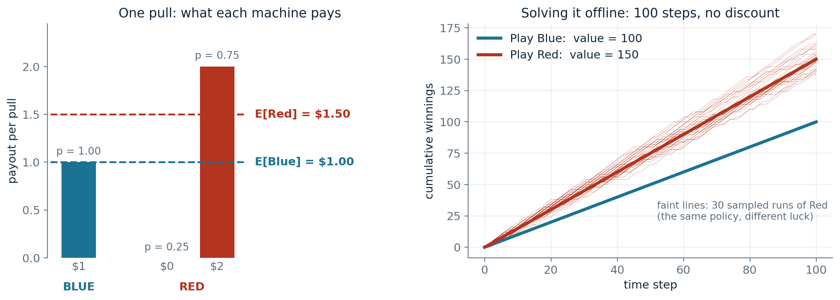
Offline planning: solve it without playing it
Two slot machines. Blue pays $1 every time. Red pays $2 three quarters of the time and nothing otherwise.
Write it as an MDP: two actions (Blue, Red), two states (Win, Lose). The states exist only so the rewards can depend on where you land - both have the same value.
Solving an MDP is offline planning. You determine every quantity by computation, you need to know all the details, and you never actually play the game.
COMP 469 | Markov Decision Processes II
61
Notes:
Start by asking the room which machine to play if they get many pulls. They will say Red immediately, and they will be right - expected value $1.50 against $1.00. The point is not that the answer is hard. The point is how they got it: purely by computation, from a full specification of the game, without pulling a single lever. Over 100 steps with no discount, always-Red is worth 150 and always-Blue is worth 100. That is policy evaluation on a two-state MDP. Note the faint lines in the right panel. Every one of them is the same optimal policy; they differ only in luck. When we actually play, we will not land on exactly 150, and that variance is going to matter enormously in a moment. Aside on the two-state encoding: it is a slightly awkward formalization, since the state does not affect anything. The states are there only so that the reward can be attached to a transition.

Slide 62
Now the same game, with one thing removed
What you knew before
What you know now
Blue: $1 every time.
Red: 75% chance of $2, 25% chance of $0.
Blue: $1 every time.
Red: ??% chance of $2, ??% chance of $0.
Compute, decide, act. No surprises.
Same states. Same actions. Same MDP structure. You simply do not have the numbers.
Let's play. Ten pulls on Red:
$0
$0
$0
$2
$0
$2
$0
$0
$0
$0
Now: do you keep playing Red? For how long? If you give up on it, is there ever a reason to come back? Notice that none of these are questions the MDP machinery can answer.
COMP 469 | Markov Decision Processes II
62
Notes:
Run this live. Ask them what to play, reveal the payouts one at a time from the sequence on the slide, and let the discomfort build. After three zeros somebody will want to switch to Blue. Then press: how do you know three zeros is bad luck rather than bad odds? Under the original 75 percent odds, three zeros in a row has probability about 1.6 percent - unlikely, but not impossible. And if you switch to Blue permanently, you will never learn otherwise. Draw out the asymmetry: playing Blue gives you money but no information, since you already know exactly what Blue does. Information only arrives when you play Red. That asymmetry is the seed of the whole exploration-exploitation literature. Land it: the MDP has not changed at all. Same states, same actions, same structure. Only your knowledge changed, and suddenly the problem is much harder.

Slide 63
That was not planning. That was learning.
There was still an MDP - you just could not solve it by computation alone, because you did not know its parameters. You had to act in order to find them out.
Exploration
You have to try actions you are unsure about, purely to gain information.
Exploitation
Eventually you have to use what you know and go collect the rewards.
Regret
Even if you learn intelligently, you will make mistakes along the way. There is a gap between what you got and what you would have got knowing the answer up front.
Sampling
Because outcomes are random, one observation proves nothing. You have to try things repeatedly, and statistics becomes unavoidable.
Difficulty
This was about the simplest MDP imaginable and it became genuinely unclear what to do. Learning is much harder than solving a known MDP.
COMP 469 | Markov Decision Processes II
63
Notes:
Name what just happened: that was reinforcement learning, and every one of these five ideas came up organically in the last three minutes without anyone defining them. Exploration versus exploitation is the headline tension and it has no clean resolution - it is a genuine trade-off you manage rather than solve. Note that in this game exploration and exploitation are cleanly separable, since Blue yields no information; in general they are tangled, because the informative action is often also a reasonable one. Regret is worth defining carefully because it is the standard evaluation criterion in bandit theory: how much worse did you do than an oracle who knew the parameters from the start. Good algorithms do not have zero regret; they have regret that grows slowly. Setup for next week: we keep the MDP formalism entirely. States and actions are known. T and R are not. Everything we built today gets rebuilt to work from samples instead of from a model - and this is exactly where Q-values pay off.

Slide 64
Where this shows up outside the classroom
Robotics and control
Operations research
Navigation, manipulation, and the self-charging robot from 17.1.4. Noisy actuators are the canonical source of stochastic transitions.
Inventory, queueing, maintenance scheduling. MDPs have been studied in OR and control theory for decades, independently of AI.
Clinical decision making
Security operations
Treatment policies over a course of care, where each decision changes the state the next decision is made in.
Contain a suspicious account now, or gather more evidence first? Containment has a certain cost in disruption; waiting risks lateral movement with some probability. States are investigation stages, actions are response steps, and the discount encodes how fast an incident can escalate.
The introduction of uncertainty is what brings MDPs closer to the real world than deterministic search. That is also what makes getting the reward function right so consequential.
COMP 469 | Markov Decision Processes II
64
Notes:
Keep this brisk - it is a breather slide, not new content. The purpose is to show that MDPs are not a gridworld toy. The security example is the one to spend thirty seconds on, since several students are in the NETSEC club and it makes the formalism concrete in a domain they care about. Frame the trade-off precisely: disabling an account has a known, immediate, certain cost in disruption; waiting to collect more evidence has an uncertain cost that depends on whether the account is actually compromised and how fast an attacker moves. That is exactly a reward-now versus discounted-future-reward trade-off under a stochastic transition model. Worth naming honestly: in that domain you almost never know T, which puts you in the reinforcement learning setting, with the additional problem that exploration is expensive and sometimes unethical. That constraint is a real research area.

Slide 65
Common mistakes, and how to avoid them
Putting the max inside the sum
Pulling R outside the expectation
The max is over actions and belongs outside. The sum is over outcomes and belongs inside. Swapping them means choosing your action after seeing the dice.
R depends on s', so it must be averaged too. It only comes out when the reward is independent of the outcome.
Confusing V-pi with V*
Forgetting the wall-bounce probability
V-pi is the value of a specific policy, possibly a bad one. V* is the value of the best policy. Policy evaluation gives the first; value iteration gives the second.
When a slip direction is blocked, that probability mass returns to the current state. Collect duplicate successors before averaging or your probabilities will not sum to one.
Treating gamma as a tuning knob
Assuming a fixed policy means no randomness
Gamma is part of the problem statement. Changing it to speed up convergence changes which policy is optimal.
Fixing pi removes the choice, not the stochastic transitions. The chance nodes are still there.
COMP 469 | Markov Decision Processes II
65
Notes:
Run through these quickly. Every one is drawn from mistakes that show up on homework and exams every term. The first is the most consequential and has a nice interpretation worth stating: if you put the max inside the sum, you are computing the value of an agent who gets to choose its action after seeing the outcome of the dice. That agent is clairvoyant, and its value is strictly higher than V*. It is the same error as confusing expectimax with max over outcomes. The gamma point deserves repeating because it is conceptual rather than mechanical, and because it is the one they are most likely to commit in a real project rather than on an exam. Tell them this slide is a reasonable pre-exam checklist.

Slide 66
One page, everything
Bellman, values
V*(s) = max_{a} Σ_{s'} T(s,a,s')[R(s,a,s') + γV*(s')]
Bellman, Q-values
Q*(s,a) = Σ_{s'} T(s,a,s')[R(s,a,s') + γ max_{a'} Q*(s',a')]
Value iteration
V_{k+1}(s) ← max_{a} Σ_{s'} T(s,a,s')[R(s,a,s') + γV_{k}(s')]
Policy evaluation
V^{π}_{k+1}(s) ← Σ_{s'} T(s,π(s),s')[R(s,π(s),s') + γV^{π}_{k}(s')]
Policy extraction, from V
π*(s) = argmax_{a} Σ_{s'} T(s,a,s')[R(s,a,s') + γV*(s')]
Policy extraction, from Q
π*(s) = argmax_{a} Q*(s,a)
Policy improvement
π_{i+1}(s) = argmax_{a} Σ_{s'} T(s,a,s')[R(s,a,s') + γV^{π_{i}}(s')]
Utility bound
U_{h} ≤ R_{max} / (1 - γ)
Contraction
|| BU - BU' ||∞ ≤ γ || U - U' ||∞
Every line is the same one-step lookahead. Learn the pattern, not the list.
COMP 469 | Markov Decision Processes II
66
Notes:
Tell them to photograph this one. It is also a fair statement of what is in scope for the exam from this lecture. Point out the visual pattern deliberately: rows three through seven are textually almost identical. The differences are exactly the four dimensions we identified - max present or absent, max or argmax, which index advances, and whether the future term is V, V-pi, or Q. Do not let them treat this as nine things to memorize. It is one thing with nine presentations, and the exam will test whether they know which.

Slide 67
Next time
Reinforcement Learning
Same MDP. You know the states and the actions. You do not know the transition function or the rewards. Go.
Read
AIMA 17.1 and 17.2 in full. Section 17.3 on bandits is optional but it is the formal version of the game we just played.
Do
Homework 3: implement value iteration, policy evaluation, and policy iteration on gridworld. Use two copies of V, not one.
Think about
Why does learning Q-values let you act without a model, and why might you be able to learn optimal Q-values while behaving sub-optimally?
COMP 469 | Markov Decision Processes II
67
Notes:
Close on the one-sentence definition of the RL setting, because it is the cleanest way to see that nothing about the formalism changes - only what you are given. The think-about question is deliberately the hardest thing on the slide. It points at off-policy learning, which is the genuinely surprising property of Q-learning: you can behave badly, even randomly, and still converge to the optimal Q-function. Do not answer it now. Reiterate the two-copies instruction for the homework; it is the most common autograder failure. If there is time left, take questions on the Bellman equation specifically rather than general questions - that is where the confusion, if any, will be.

